Slide 1


Delivering IaaS for the Greek
Academic and Research Community
Vangelis Koukis
vkoukis@grnet.gr
Technical Coordinator, ∼okeanos Project

Slide 2
Outline
∼okeanos ?
Rationale
Design
Platform
Features
Internals
Opensource
Upcoming

Slide 3
What is ∼okeanos?
‘okeanos’ is Greek for ‘ocean’.
Oceans capture, store and deliver
energy, oxygen and life around the planet.

Slide 4
Simplicity

Slide 5
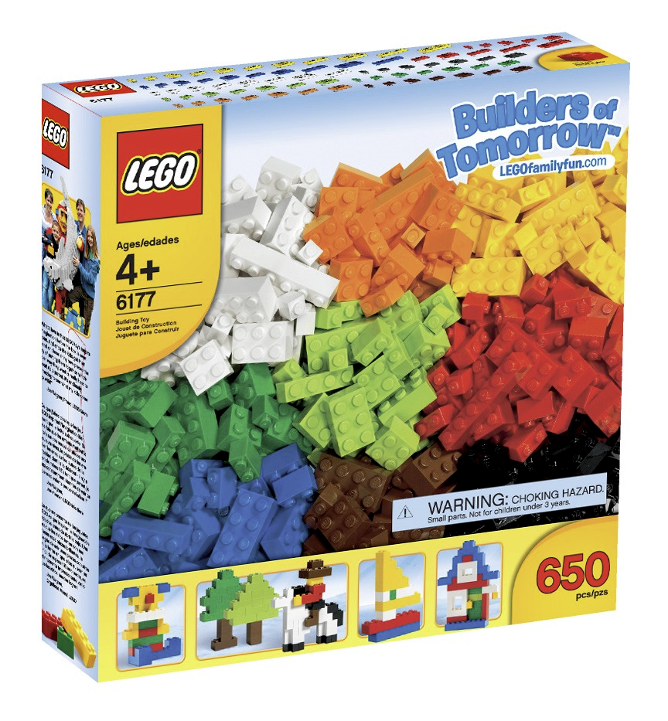
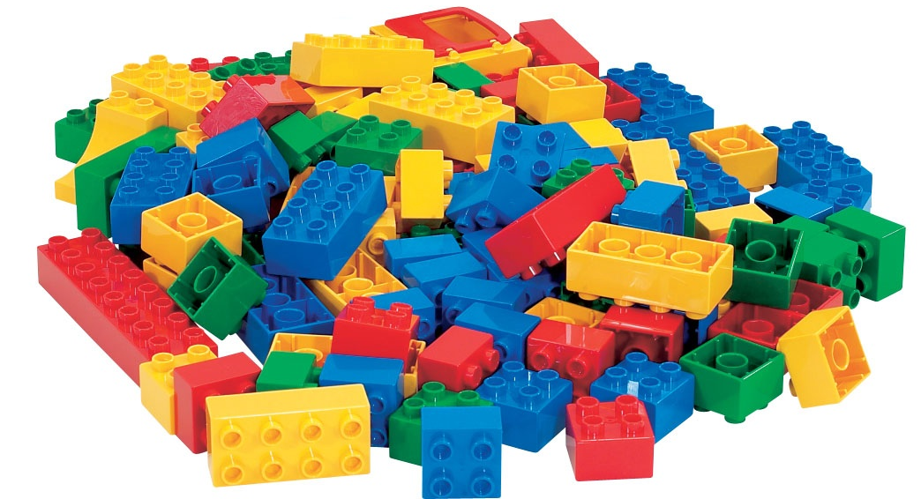

Slide 6
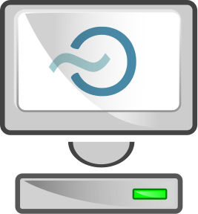
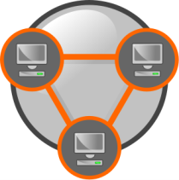
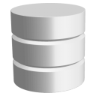

Virtual Machines
Compute
Virtual Ethernets
Network
Virtual Disks
Storage
Virtual Firewalls
Security

Slide 7
Flexibility

Slide 8
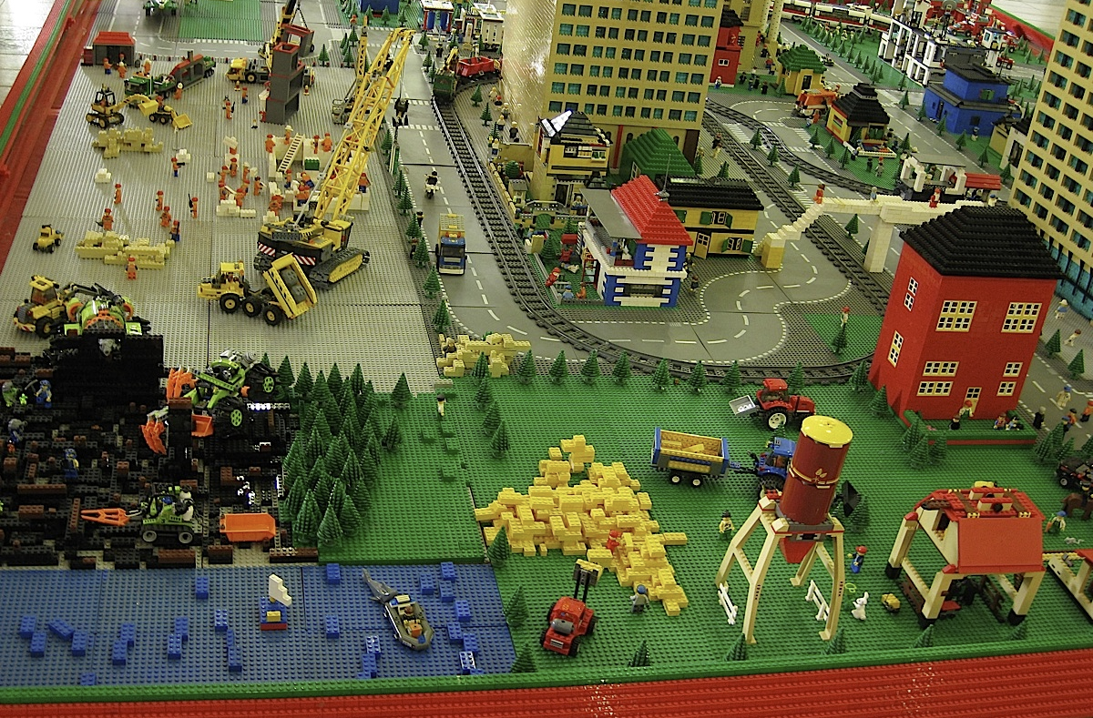

Slide 9



5x
2x
8x
1x

Slide 10
∼okeanos service
Goal: Production-quality IaaS
Working Alpha: from July 2011 / 350 VMs / 200 alpha users
Target group: GRNET’s customers
  direct: IT depts of connected institutions
  indirect: university students, researchers in academia
Users manage resources over
  a simple, elegant UI, or
  a REST API, for full programmatic control

Slide 11
Rationale

Slide 12
How it all started
Need for easy, secure access to GRNET’s datacenters
  User friendliness, simplicity
Scalable to the thousands
  #VMs, TBs, users (Pithos: ∼10k)
running within GRNET’s AAI Federation
Resell or build your own?

Slide 13
Build on commercial IaaS?
Commercial IaaS
  Amazon EC2 not an end-user service
  Need to develop custom UI, AAI layers
  Vendor lock-in
  Unsuitable for IT depts
    persistent, long-term servers, custom networking requirements
Gain know-how, build on own IaaS → reuse
for own services

Slide 14
What about opensource?
Eucalyptus, OpenNebula, OpenStack
Need a mature opensource core to build around
Maturity, production-readiness?
  proven in production environments, predictable
Extensibility?
Flexibility?
Upgradeability, maintainability?

Slide 15
Design

Slide 16
∼okeanos design decisions
Reuse existing components
Build on Google Ganeti
target commodity hardware
release to the community as opensource

Slide 17
∼okeanos design principles
No need to make the world
No need to support everything
  Service developed and maintained by ∼10-15 people
Start from the architecture…
  …then discover, combine, reuse the right components
And for everything that’s not already available
  Do it yourself!

Slide 18
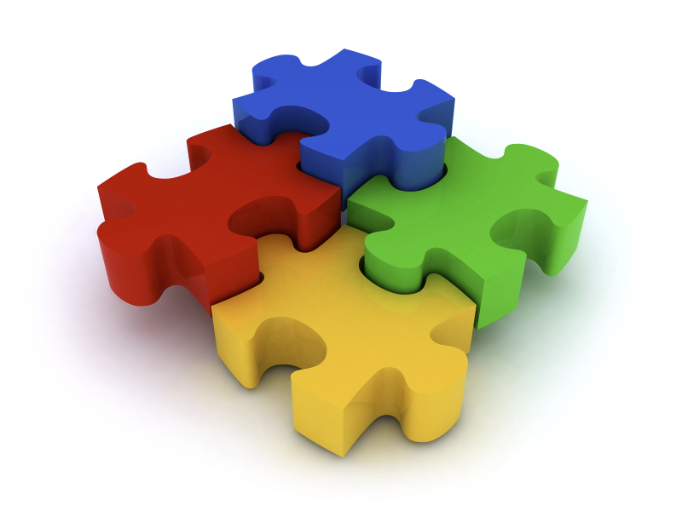

Slide 19
Jigsaw puzzle
Synnefo
  custom cloud management software to power ∼okeanos
Google Ganeti backend
  VM cluster management: physical nodes, VMs, migrations
OpenStack Compute API v1.1
  with custom extensions whenever necessary
Then everything comes together
  UI, Networking, Images, Storage, Monitoring, Identity management, Accounting, Billing, Clients, Helpdesk

Slide 20
Why Ganeti?
No need to reinvent the wheel
Scalable, proven software infrastructure
  Built with reliability and redundancy in mind
  Combines open components (KVM, LVM, DRBD)
  Well-maintained, readable code
VM cluster management in production is
serious business
  reliable VM control, VM migrations, resource allocation
  handling node downtime, software upgrades

Slide 21
Why Ganeti?
GRNET already had long experience with Ganeti
  provides ∼280 VMs to NOCs through the ViMa service
  involved in development, contributing patches upstream
Build on existing know-how for ∼okeanos
  Common backend, common fixes
  reuse of experience and operational procedures
  simplified, less error-prone deployment

Slide 22
Platform

Slide 23


Software Stack
REST API
Multiple users,
multiple resources
Synnefo
Multiple VMs
on cluster
Ganeti
Single
VM
KVM

Slide 24







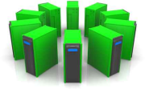
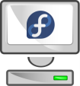

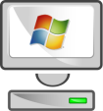
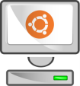

Platform Design
Web Client
CLI Client
Web Client 2
user@home
admin@home
OpenStack Compute API v1.1
GRNET Proprietary
GRNET
datacenter
Synnefo cloud management software
Google Ganeti
Debian
KVM
Direct Outof Band Access
Virtual
Hardware

Slide 25
Features

Slide 26






Virtual Machine Actions
My_Windows_desktop
Start
Console
Reboot
Shutdown
Destroy

Slide 27
IaaS – Compute (1)
Virtual Machines
  powered by KVM
    Linux and Windows guests, on Debian hosts
  Google Ganeti for VM cluster management
  accessible by the end-user over the Web or programmatically (OpenStack Compute v1.1)

Slide 28
IaaS – Compute (2)
User has full control over own VMs
  Create
    Select # CPUs, RAM, System Disk
    OS selection from pre-defined Images
    popular Linux distros (Fedora, Debian, Ubuntu)
    Windows Server 2008 R2
  Start, Shutdown, Reboot, Destroy
  Out-of-Band console over VNC for troubleshooting

Slide 29
IaaS – Compute (3)
REST API for VM management
  OpenStack Compute v1.1 compatible
  3rd party tools and client libraries
  custom extensions for yet-unsupported functionality
  Python & Django implementation
Full-featured UI in JS/jQuery
  UI is just another API client
  All UI operations happen over the API

Slide 30


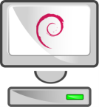

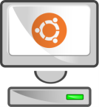
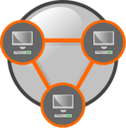
IaaS – Network (Virtual Ethernets)
Internet
Private Network 1
Private Network 2
Private Network 3

Slide 31
IaaS – Network - Functionality
Dual IPv4/IPv6 connectivity for each VM
Easy, platform-provided firewalling
  Array of pre-configured firewall profiles
  Or roll-your-own firewall inside VM
Multiple private, virtual L2 networks
Construct arbitrary network topologies
  e.g., deploy VMs in multi-tier configurations
Exported all the way to the API and the UI

Slide 32
Unity

Slide 33

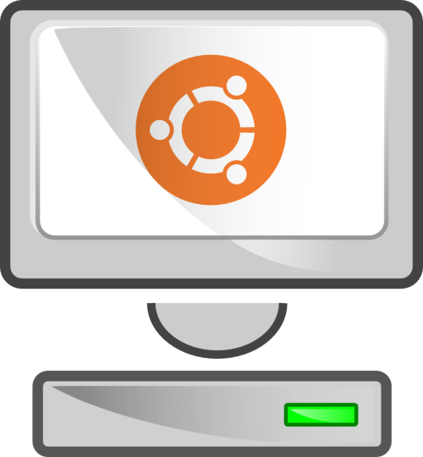

Images
Spawn
Ubuntu
my own Ubuntu
Snapshot

Slide 34
Images ↔ Storage
Clone
Ubuntu + packages
Ubuntu root
Snapshot

Slide 35
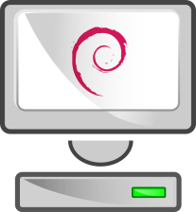

Images – Golden Image
golden Debian

Slide 36
IaaS – Storage

Slide 37

IaaS – Storage
Volume Composer
RADOS
Storage
Monitor nodes
object I/O
Maps
Object Storage nodes

Slide 38
IaaS – Storage (1)
First-phase deployment
  Pre-defined images of common OSs
  Redundant storage based on DRBD
  VMs survive node downtime or failure
Currently under testing
  Reliable distributed storage over RADOS
  Combined with custom software for snapshotting, cloning
  Dynamic virtual storage volumes

Slide 39
IaaS – Storage (2)
Multi-tier storage architecture
  Dedicated Storage Nodes (SSD, SAS, and SATA storage)
  OSDs for RADOS
Custom storage layer
  manages snapshots, creates clones over RADOS
  OS Images held as snapshots
VMs created as clones of snapshots

Slide 40
Custom Images: snf-image
Untrusted images
  Host cannot touch user-provided data
  Resize fs, change hostname, change passwords, inject files
Split design
  snf-image-host
  snf-image-helper
All customization in helper VM

Slide 41

OpenStack Object Storage API
Block storage
Content-based addressing for blocks
Every file is a collection of blocks
Web-based, command-line, and native clients
Synchronization, deduplication
Goal
  Image registry on Pithos+, common RADOS-based backend

Slide 42
Internals

Slide 43




Deployment
Web Server
REST API
ui
DB
SQL
API Server
SQL
api
aai
Logic
RAPI
snf-dispatcher
Queue
Ganeti
Master
Ganeti node
snf-gnt-eventd
KVM
…
snf-gnt-hook

Slide 44
Context

Slide 45
./kamaki
$ ipython
In [1]: from kamaki.client import Client
In [2]: c = Client('http://localhost:8000/api/v1.1', "1234527db2…")
In [3]: c.list_flavors()
…
In [4]: i = c.list_images()
In [5]: i[5]
{u'created': u'2011-06-09T00:00:00+00:00',
u'id': 7,
u'metadata': {u'values': {u'OS': u'windows',
u'size': u'11000'}},
u'name': u'Windows',
u'progress': 100,
u'status': u'ACTIVE',
u'updated': u'2011-09-12T14:47:12+00:00'}
In [6]: c.create_server('mywin1', 3, 5)

Slide 46
./kamaki
$ ./kamaki
Usage: kamaki <group> <command> [options]
…
--api=API API can be either openstack or synnefo
--url=URL API URL
--token=TOKEN use token TOKEN
…
Commands:
flavor info get flavor details
flavor list list flavors
…
image create create image
image delete delete image
$ ./kamaki server shutdown 101 --url=http://localhost:8000/api/v1.1
--token=1234527db2…

Slide 47
More interaction
Identity Management
  Provides the user base for ∼okeanos
  Once authenticated, the user retrieves an
  auth token for programmatic access
Pithos+ storage service
  Aim is to provide the Image service for ∼okeanos
  Sharing a common storage backend on RADOS
Aquarium
  Common crediting and billing infrastructure

Slide 48
Upcoming

Slide 49
Upcoming goals
short-term: Synnefo v0.8
  user-visible storage backends
  VMs with RADOS-based storage
  Custom Image registry, custom Image deployment
medium-term
  Dynamic disks, clonable / snapshottable / attachable disks
  integration with Pithos+, single user base
Beta when datacenter is fully populated

Slide 50
Upcoming goals
Credit-based resource allocation
Abstract away the Ganeti backend, replace with backend connector behind the MQ
  Release to community as reference implementation of OpenStack Compute v1.1
Support live modification of VMs in Ganeti
Snapshots, clones in storage layer
  Dramatic decrease in VM initialization time
  Support workloads with 100s of ephemeral VMs
    e.g. for scientific computation, MPI jobs

Slide 51
Sights

Slide 52
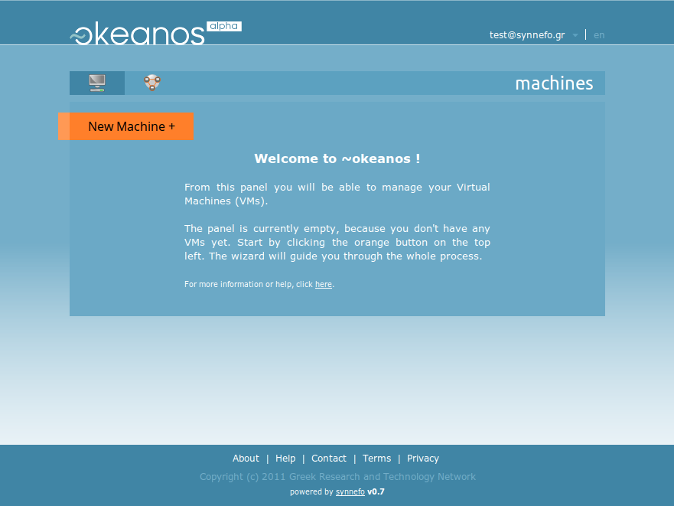

Slide 53
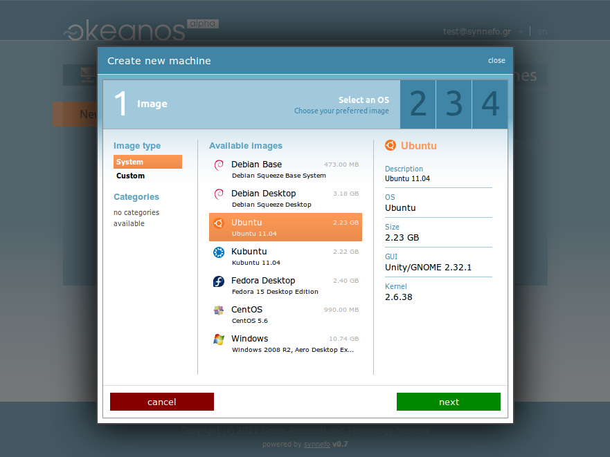

Slide 54
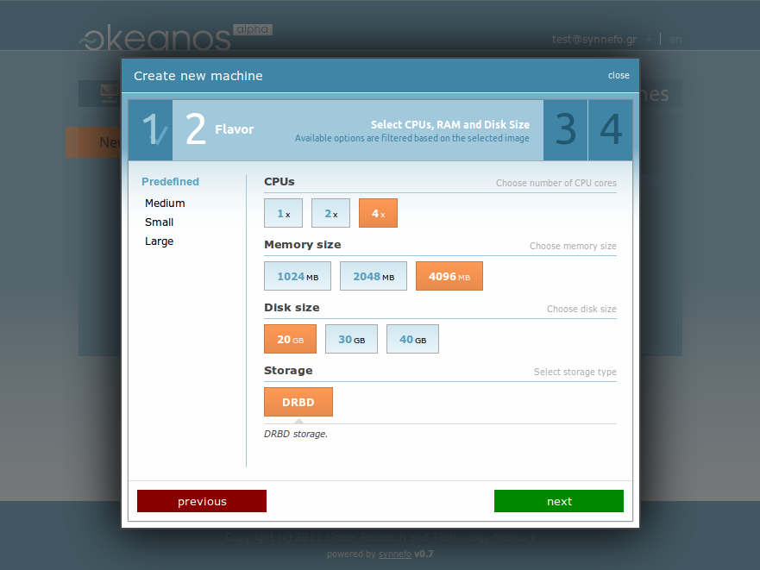

Slide 55
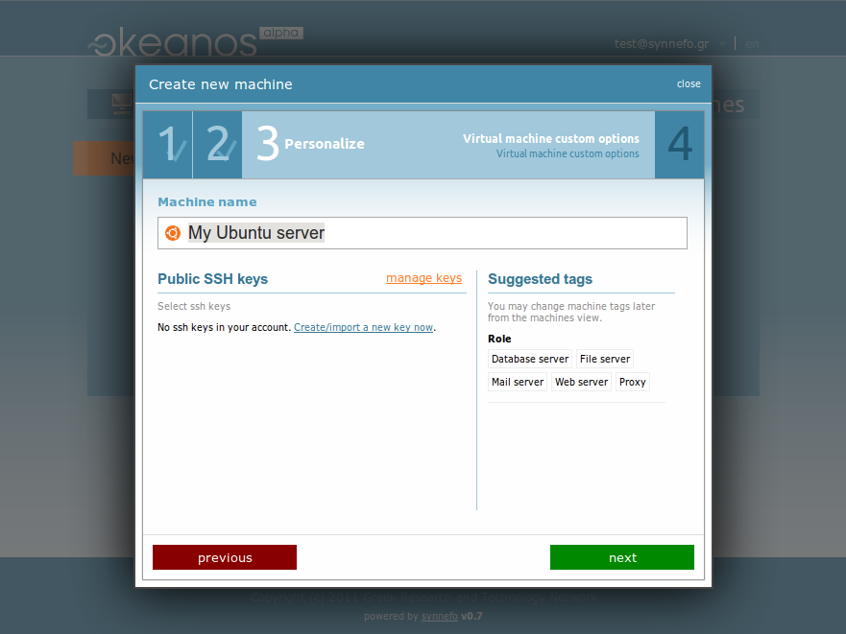

Slide 56
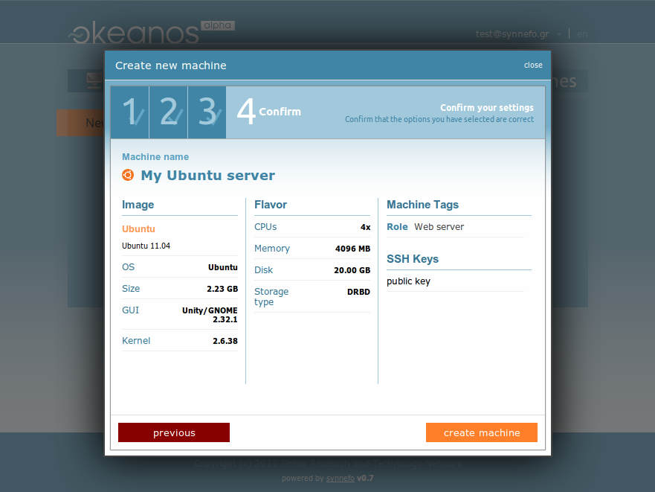

Slide 57
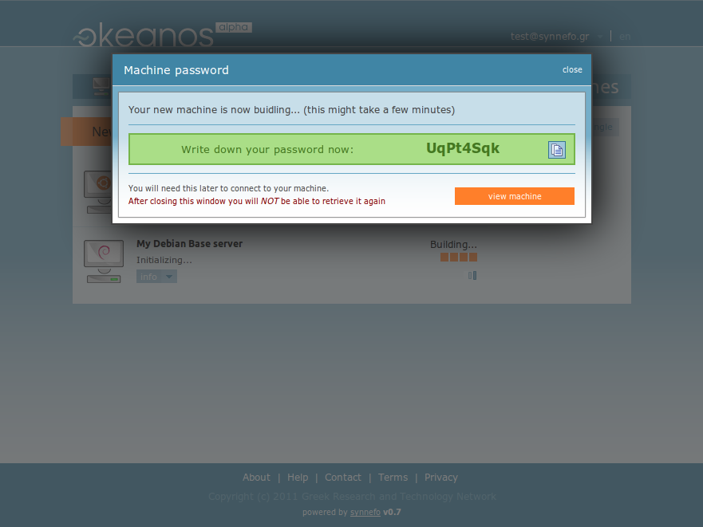

Slide 58
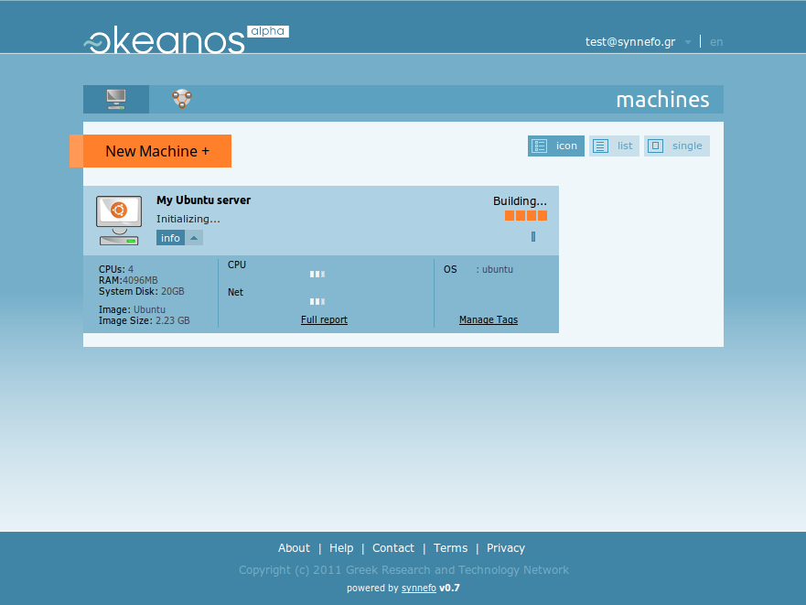

Slide 59
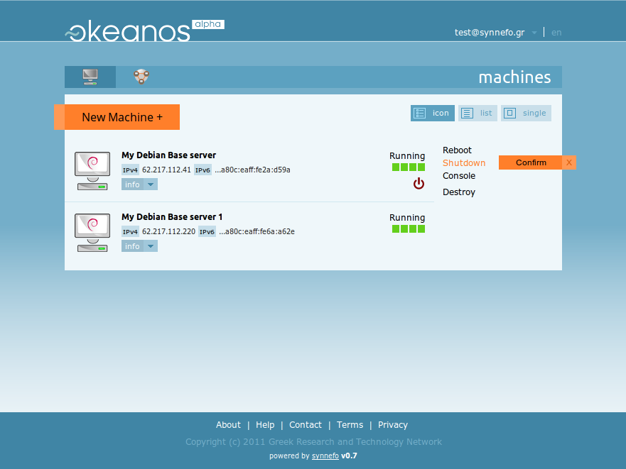

Slide 60
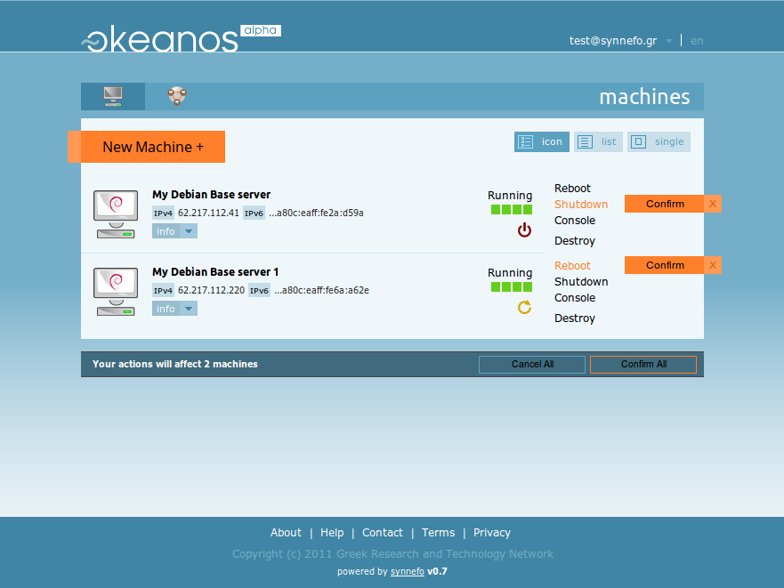

Slide 61
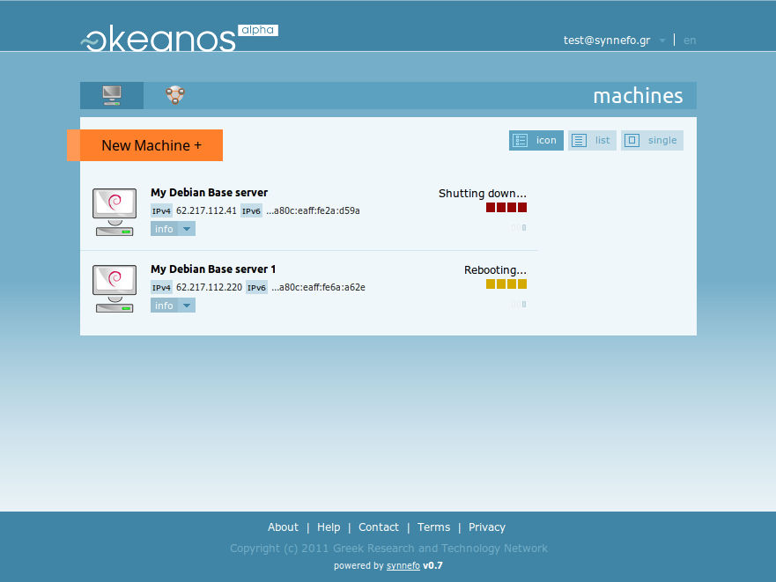

Slide 62
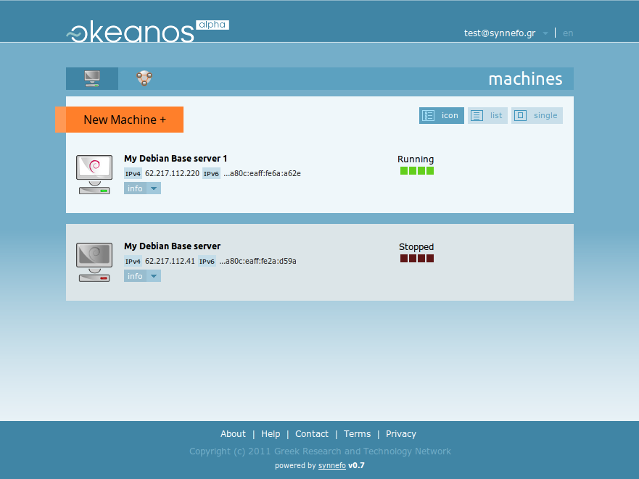

Slide 63
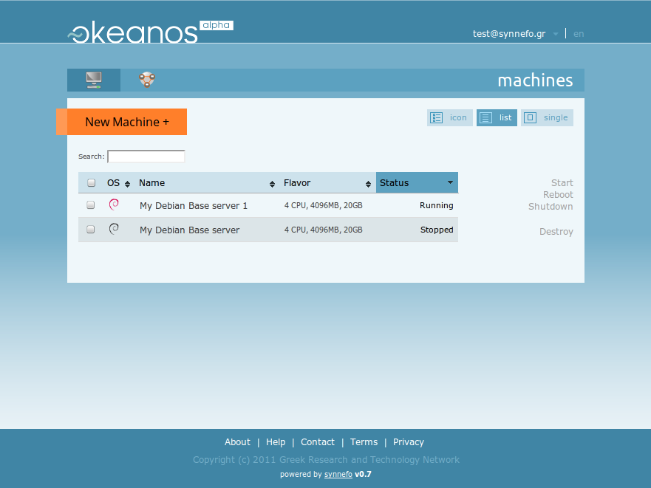

Slide 64
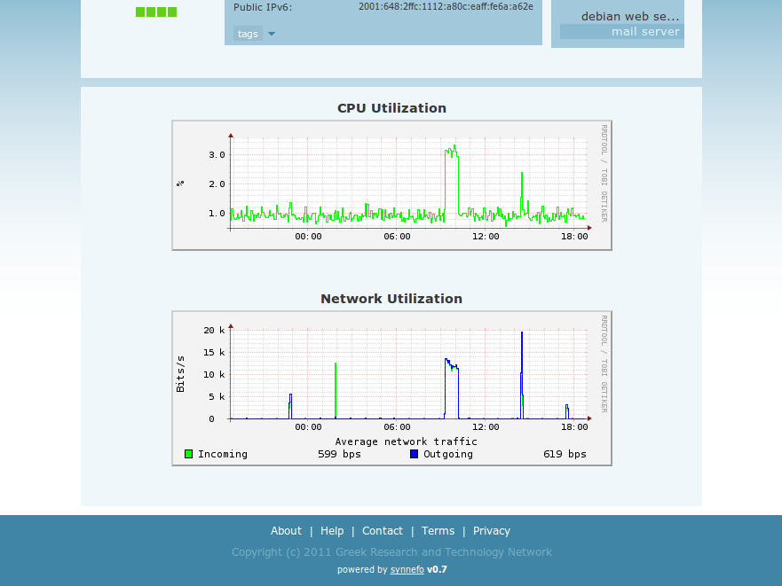

Slide 65
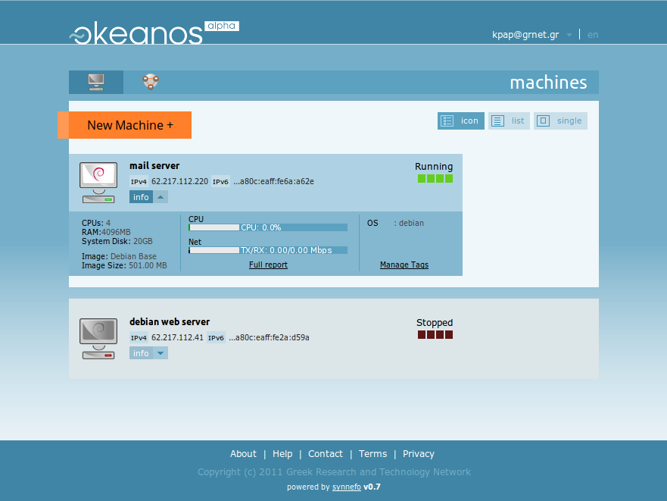

Slide 66
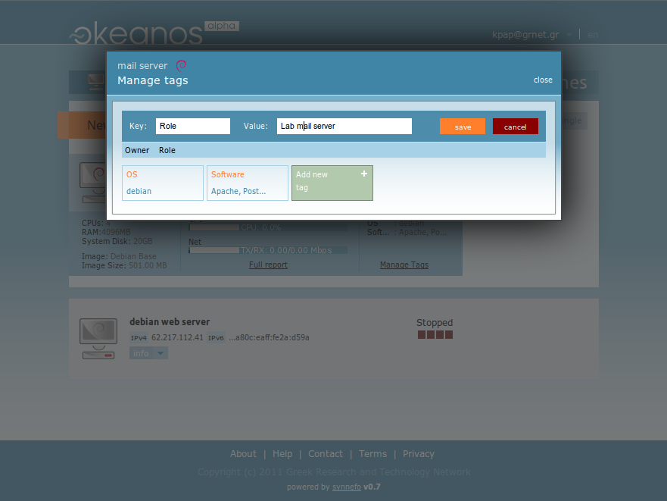

Slide 67
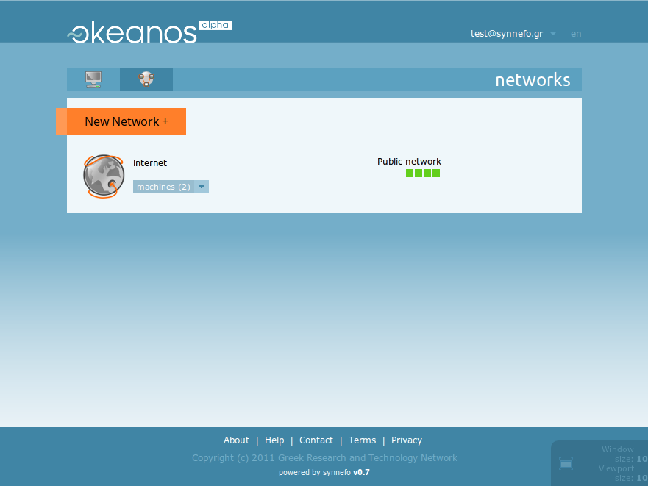

Slide 68
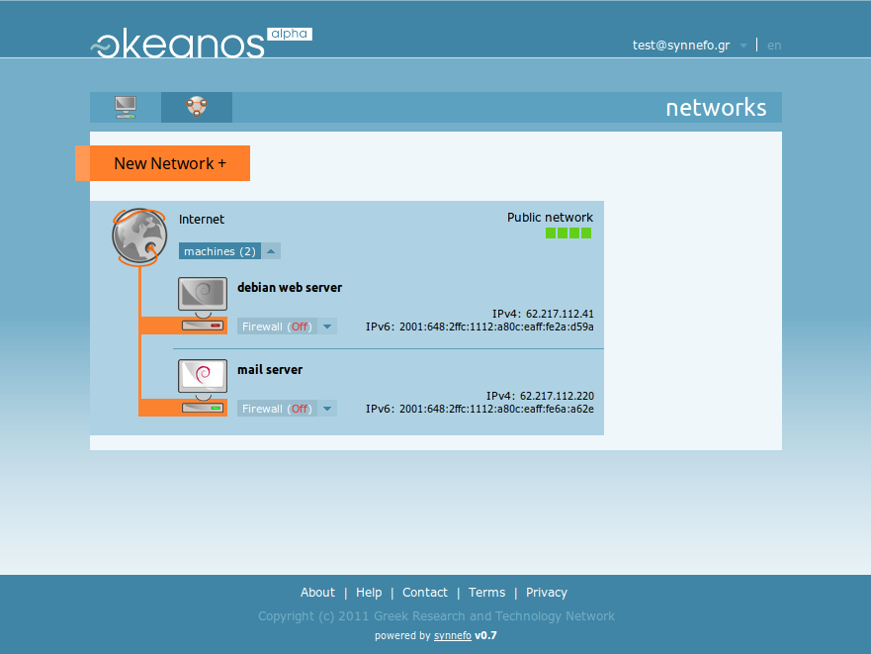

Slide 69
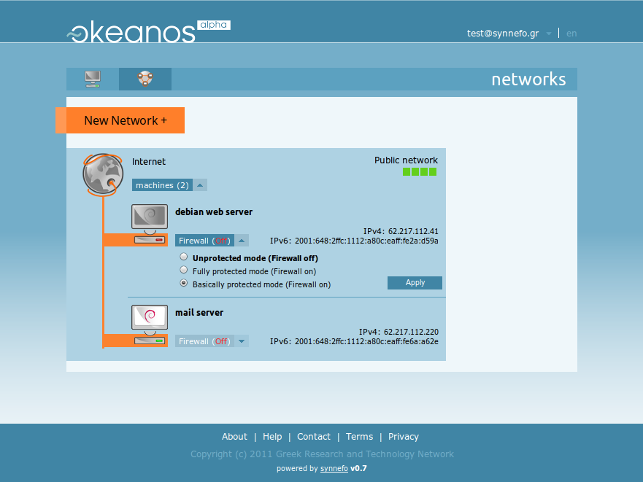

Slide 70
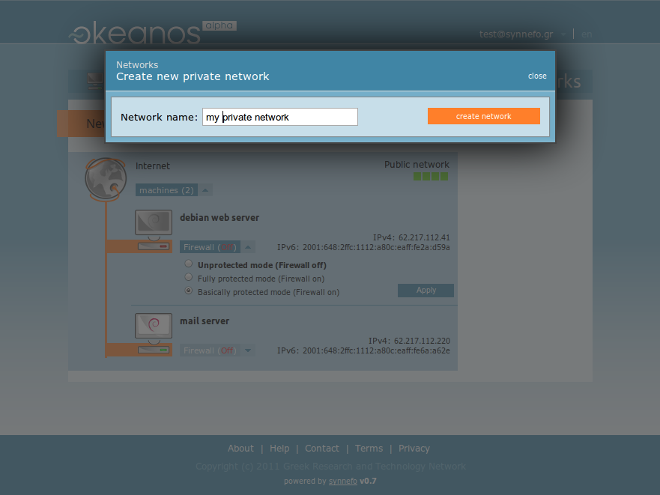

Slide 71
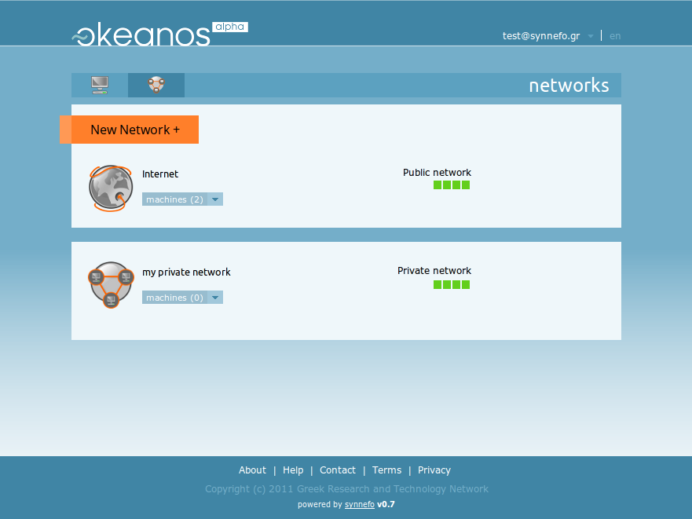

Slide 72
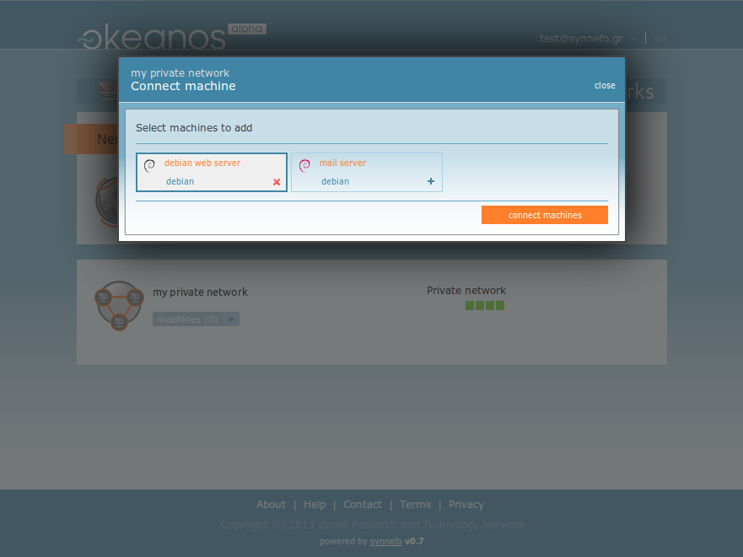

Slide 73
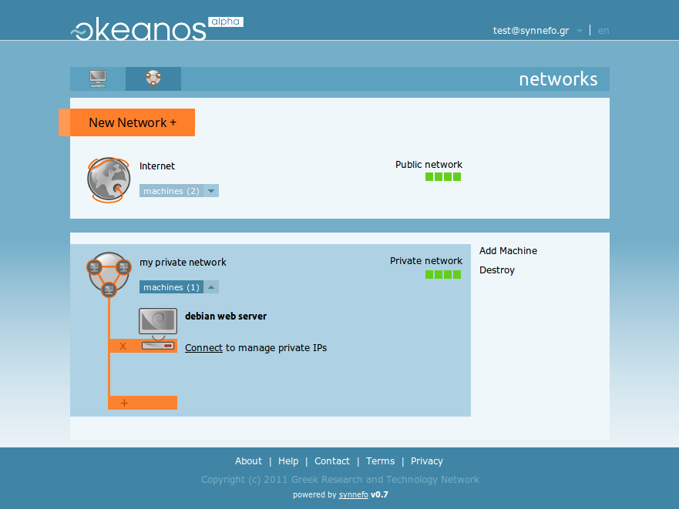

Slide 74
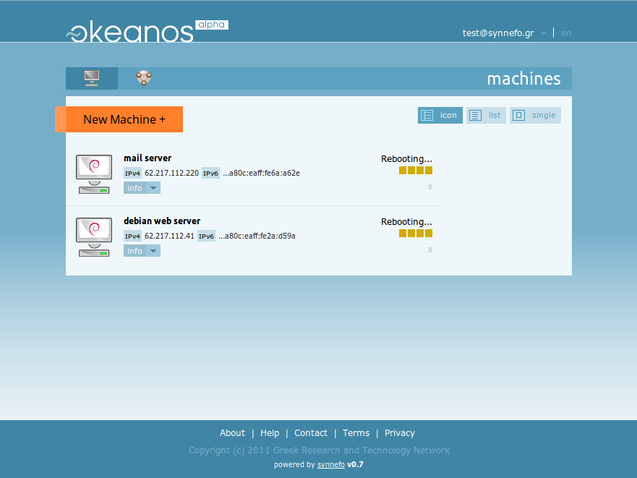

Slide 75
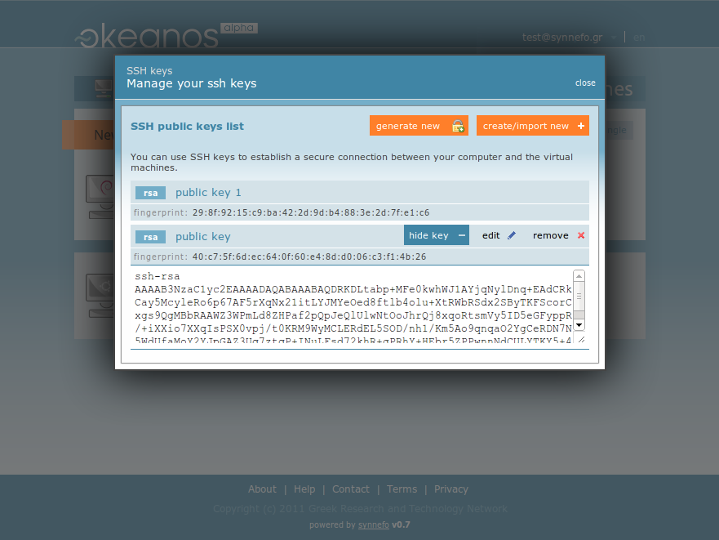

Slide 76
Open

Slide 77
Opensource
Synnefo
  https://code.grnet.gr/projects/synnefo
Pithos+
  https://code.grnet.gr/projects/pithos
Ganeti
  https://code.google.com/p/ganeti
snf-image
  https://code.grnet.gr/projects/snf-image
kamaki
  https://code.grnet.gr/projects/kamaki
vncauthproxy
  https://code.grnet.gr/projects/vncauthproxy

Slide 78
https://okeanos.grnet.gr

