Slide 1


Delivering IaaS for the Greek
Academic and Research Community
Vangelis Koukis
vkoukis@grnet.gr
Technical Coordinator, ∼okeanos Project

Slide 2
Outline
∼okeanos ?
Rationale
Design
Platform
Features
Opensource
Upcoming

Slide 3
What is ∼okeanos?
‘okeanos’ is Greek for ‘ocean’.
Oceans capture, store and deliver
energy, oxygen and life around the planet.

Slide 4
Simplicity

Slide 5
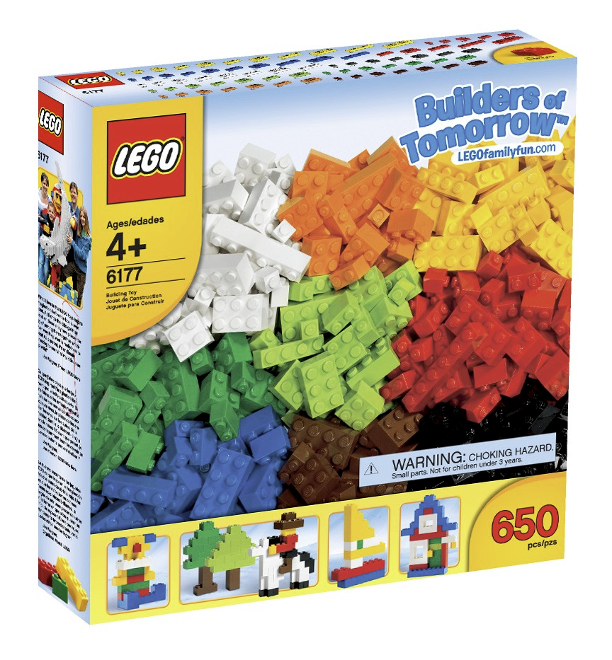
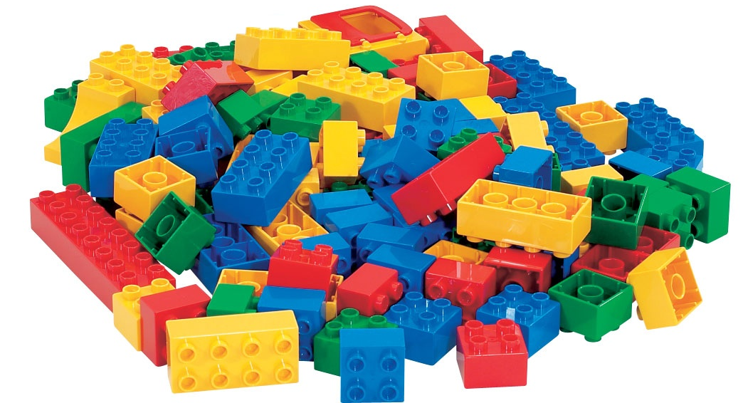

Slide 6
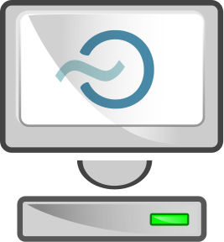
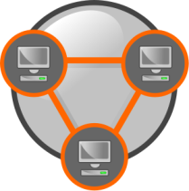
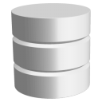

Virtual Machines
Compute
Virtual Ethernets
Network
Virtual Disks
Storage
Virtual Firewalls
Security

Slide 7
Flexibility

Slide 8
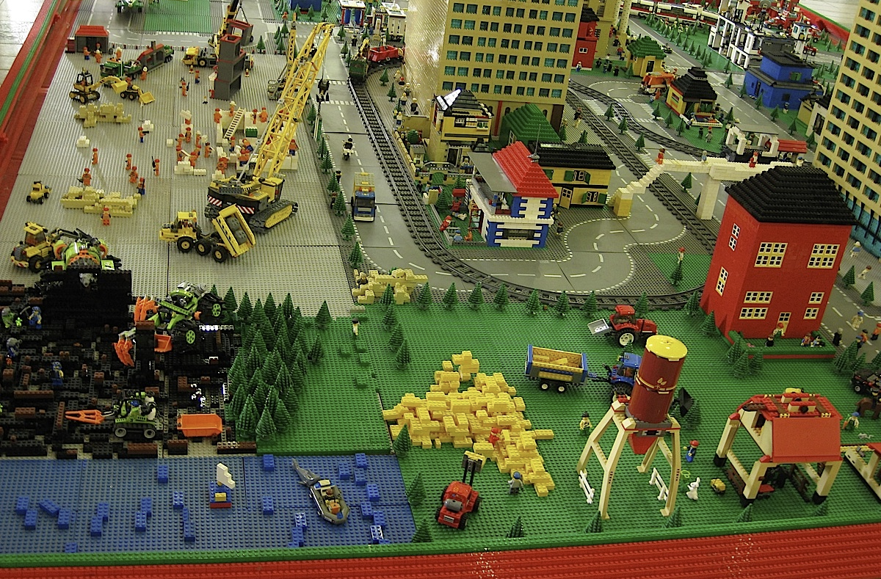

Slide 9



5x
2x
8x
1x

Slide 10
∼okeanos service
Goal: Production-quality IaaS
Now in Alpha: from July 2011 / 350 VMs / 200 alpha users
Target group: GRNET’s customers
  direct: IT depts of connected institutions
  indirect: university students, researchers in academia
Users manage resources over
  a simple, elegant UI, or
  a REST API, for full programmatic control

Slide 11
∼okeanos service
Compute: Cyclades
Files: Pithos+
Images: Plankton
Identity: Astakos
Volumes: Archipelago
Accounting/Billing: Aquarium

Slide 12
Rationale

Slide 13
How it all started
Need for easy, secure access to GRNET’s datacenters
  User friendliness, simplicity
Scalable to the thousands
  #VMs, TBs, users (Pithos: ∼10k)
running within GRNET’s AAI Federation
Resell or build your own?

Slide 14
Build on commercial IaaS?
Commercial IaaS
  Amazon EC2 not an end-user service
  Need to develop custom UI, AAI layers
  Vendor lock-in
  Unsuitable for IT depts
    persistent, long-term servers, custom networking requirements
Gain know-how, build on own IaaS → reuse
for own services
Notes:
GRNET’s contractual obligations? Storage as a Service? Desktop as a Service? Scientific Software as a Service?

Slide 15
What about opensource?
Eucalyptus, OpenNebula, OpenStack
Need a mature opensource core to build around
Maturity, production-readiness?
  proven in production environments, predictable
Extensibility?
Flexibility?
Upgradeability, maintainability?
Notes:
Mature, production-proven opensource core
with a predictable upgrade schedule

Slide 16
Design

Slide 17
∼okeanos design decisions
Reuse existing components
Build on Google Ganeti
target commodity hardware
release to the community as opensource
Notes:
FIXME: Δες μέηλ προς tchiotis@grnet, nkoziris@cslab.

Slide 18
∼okeanos design principles
No need to make the world
No need to support everything
  Service developed and maintained by ∼10-15 people
Start from the architecture…
  …then discover, combine, reuse the right components
And for everything that’s not already available
  Do it yourself!
Notes:
FIXME: tenets, decisions, principles?

Slide 19


Slide 20
Jigsaw puzzle
Synnefo
  custom cloud management software to power ∼okeanos
Google Ganeti backend
  VM cluster management: physical nodes, VMs, migrations
OpenStack APIs: Compute API v1.1, Object Storage API
  with custom extensions whenever necessary
Then everything comes together
  UI, Networking, Images, Storage, Monitoring, Identity management, Accounting, Billing, Clients, Helpdesk

Slide 21
Why Ganeti?
No need to reinvent the wheel
Scalable, proven software infrastructure
  Built with reliability and redundancy in mind
  Combines open components (KVM, LVM, DRBD)
  Well-maintained, readable code
VM cluster management in production is
serious business
  reliable VM control, VM migrations, resource allocation
  handling node downtime, software upgrades

Slide 22
Why Ganeti?
GRNET already had long experience with Ganeti
  provides ∼280 VMs to NOCs through the ViMa service
  involved in development, contributing patches upstream
Build on existing know-how for ∼okeanos
  Common backend, common fixes
  reuse of experience and operational procedures
  simplified, less error-prone deployment

Slide 23
Platform

Slide 24


Software Stack
REST API
Multiple users,
multiple resources
Synnefo
Multiple VMs
on cluster
Ganeti
Single
VM
KVM

Slide 25







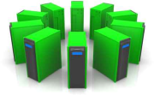
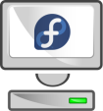


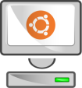

Platform Design
Web Client
CLI Client
Web Client 2
user@home
admin@home
OpenStack Compute API v1.1
GRNET Proprietary
GRNET
datacenter
Synnefo cloud management software
Google Ganeti
Debian
KVM
Direct Outof Band Access
Virtual
Hardware

Slide 26
Features

Slide 27






Virtual Machine Actions
My_Windows_desktop
Start
Console
Reboot
Shutdown
Destroy

Slide 28
IaaS – Compute (1)
Virtual Machines
  powered by KVM
    Linux and Windows guests, on Debian hosts
  Google Ganeti for VM cluster management
  accessible by the end-user over the Web or programmatically (OpenStack Compute v1.1)

Slide 29
IaaS – Compute (2)
User has full control over own VMs
  Create
    Select # CPUs, RAM, System Disk
    OS selection from pre-defined Images, or custom Images
    popular Linux distros (Fedora, Debian, Ubuntu)
    Windows Server 2008 R2
  Start, Shutdown, Reboot, Destroy
  Out-of-Band console over VNC for troubleshooting

Slide 30
IaaS – Compute (3)
REST API for VM management
  OpenStack Compute v1.1 compatible
  3rd party tools and client libraries
  custom extensions for yet-unsupported functionality
  Python & Django implementation
Full-featured UI in JS/jQuery
  UI is just another API client
  All UI operations happen over the API

Slide 31


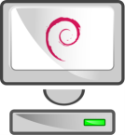

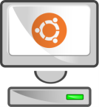
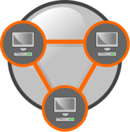
IaaS – Network (Virtual Ethernets)
Internet
Private Network 1
Private Network 2
Private Network 3

Slide 32
IaaS – Network - Functionality
Dual IPv4/IPv6 connectivity for each VM
Easy, platform-provided firewalling
  Array of pre-configured firewall profiles
  Or roll-your-own firewall inside VM
Multiple private, virtual L2 networks
Construct arbitrary network topologies
  e.g., deploy VMs in multi-tier configurations
Exported all the way to the API and the UI
Notes:
από [apollon]: “Need for a new model: large IPv4 subnets, Layer-2 isolation of guests, IP pool management and automatic
network configuration using DHCP and IPv6 stateless autoconfiguration.”

Slide 33
Unity

Slide 34

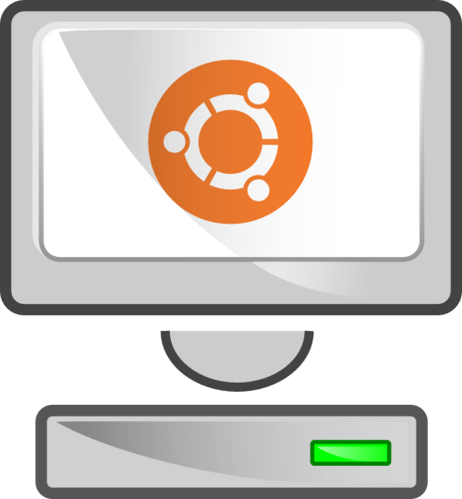

Images
Spawn
Ubuntu
my own Ubuntu
Freeze
Notes:
FIXME: Ubuntu machine

Slide 35
Images ↔ Storage
Clone
Ubuntu + packages
Ubuntu root
Snapshot
Notes:
FIXME: Ubuntu machine

Slide 36
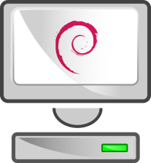

Images – Golden Image
golden Debian

Slide 37
IaaS – Storage

Slide 38

IaaS – Storage
Archipelago
Volume Composer
RADOS
Storage
Monitor nodes
object I/O
Maps
Object Storage nodes

Slide 39
IaaS – Storage (1)
First-phase deployment
  System-provided and custom user Images
  Redundant storage based on DRBD
  VMs survive node downtime or failure
Currently under testing
  Reliable distributed storage over RADOS
  Combined with custom software for snapshotting, cloning
  Dynamic virtual storage volumes

Slide 40
IaaS – Storage (2)
Multi-tier storage architecture
  Dedicated Storage Nodes (SSD, SAS, and SATA storage)
  OSDs for RADOS
Custom storage layer: Archipelago
  manages snapshots, creates clones over RADOS
  OS Images held as snapshots
VMs created as clones of snapshots

Slide 41
Custom Images: snf-image
Untrusted images
  Host cannot touch user-provided data
  Resize fs, change hostname, change passwords, inject files
Split design
  snf-image-host
  snf-image-helper
All customization in helper VM

Slide 42

OpenStack Object Storage API
Block storage
Content-based addressing for blocks
Every file is a collection of blocks
Web-based, command-line, and native clients
Synchronization, deduplication
An integral part of ∼okeanos
  User files, Image registry for VM Images
  Goal: use common backend with Archipelago

Slide 43
Integration

Slide 44
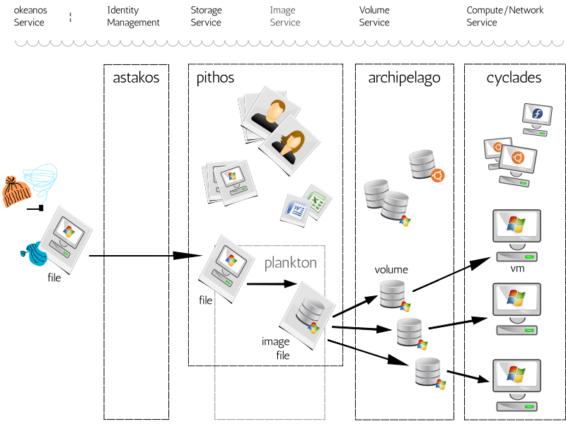

Slide 45
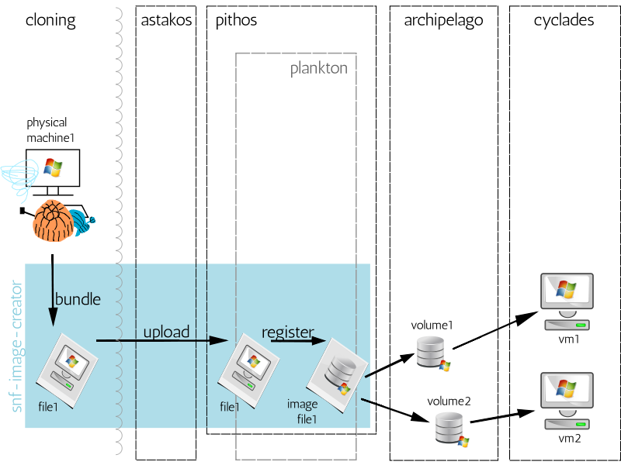

Slide 46
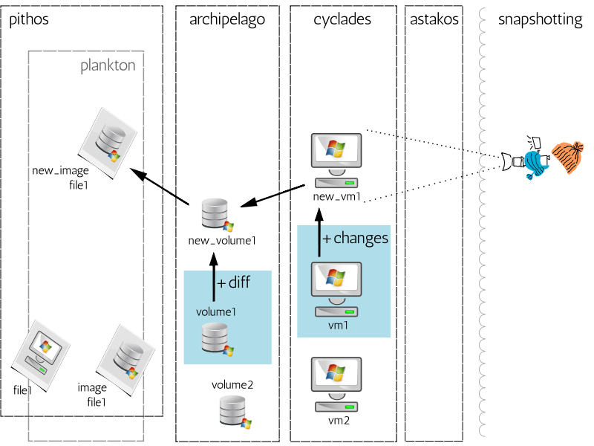

Slide 47
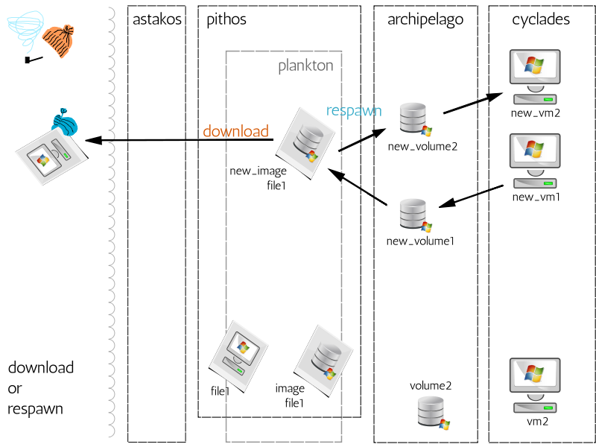

Slide 48
Support services
Identity: Astakos
  Provides the user base for ∼okeanos
  Once authenticated, the user retrieves a
  common auth token for programmatic access
Accounting / Billing: Aquarium
  Underlying crediting and billing infrastructure

Slide 49
Tools

Slide 50
./kamaki
$ ipython
In [1]: from kamaki.client import Client
In [2]: c = Client('http://localhost:8000/api/v1.1', "1234527db2…")
In [3]: c.list_flavors()
…
In [4]: i = c.list_images()
In [5]: i[5]
{u'created': u'2011-06-09T00:00:00+00:00',
u'id': 7,
u'metadata': {u'values': {u'OS': u'windows',
u'size': u'11000'}},
u'name': u'Windows',
u'progress': 100,
u'status': u'ACTIVE',
u'updated': u'2011-09-12T14:47:12+00:00'}
In [6]: c.create_server('mywin1', 3, 5)

Slide 51
./kamaki
$ ./kamaki
Usage: kamaki <group> <command> [options]
…
--api=API API can be either openstack or synnefo
--url=URL API URL
--token=TOKEN use token TOKEN
…
Commands:
flavor info get flavor details
flavor list list flavors
…
image create create image
image delete delete image
$ ./kamaki server shutdown 101 --url=http://localhost:8000/api/v1.1
--token=1234527db2…

Slide 52
Upcoming

Slide 53
Current and Upcoming features
Now: Alpha2
  Common user base, custom user images on Pithos+
short-term: Synnefo v0.10, Beta
  Ultra-lightweight VMs on Archipelago with RADOS backend
medium-term
  OCCI bridge
  Volumes: clonable / snapshottable / attachable disks
Upcoming beta in fully populated datacenter

Slide 54
Sights

Slide 55
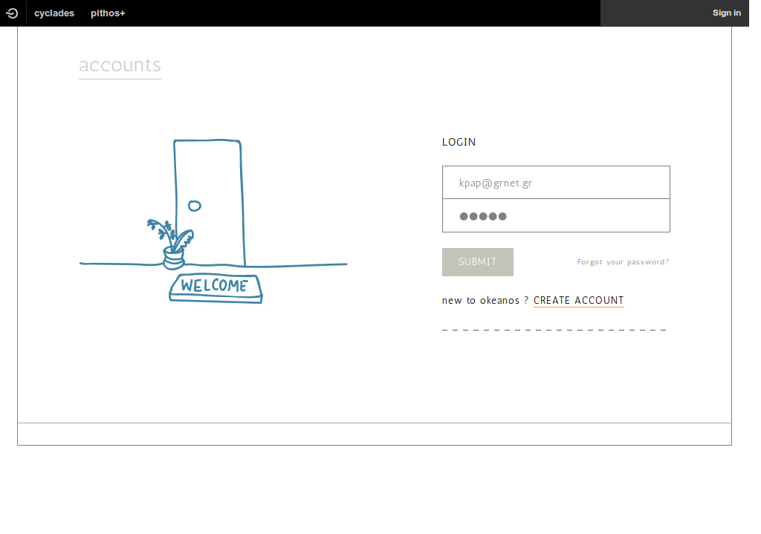

Slide 56
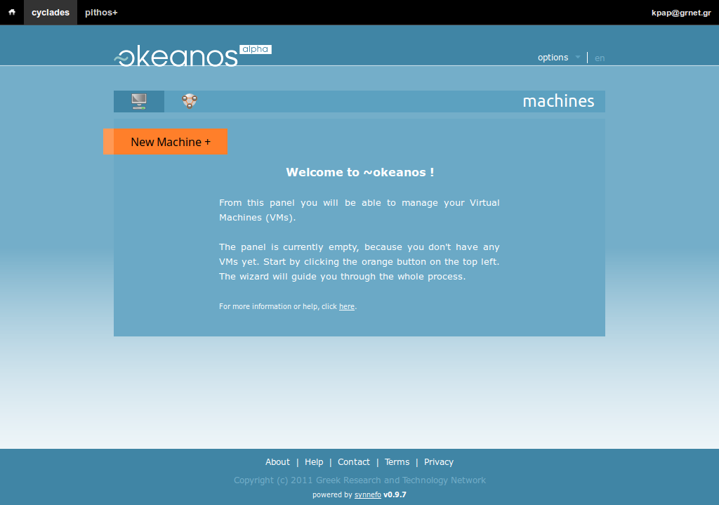

Slide 57
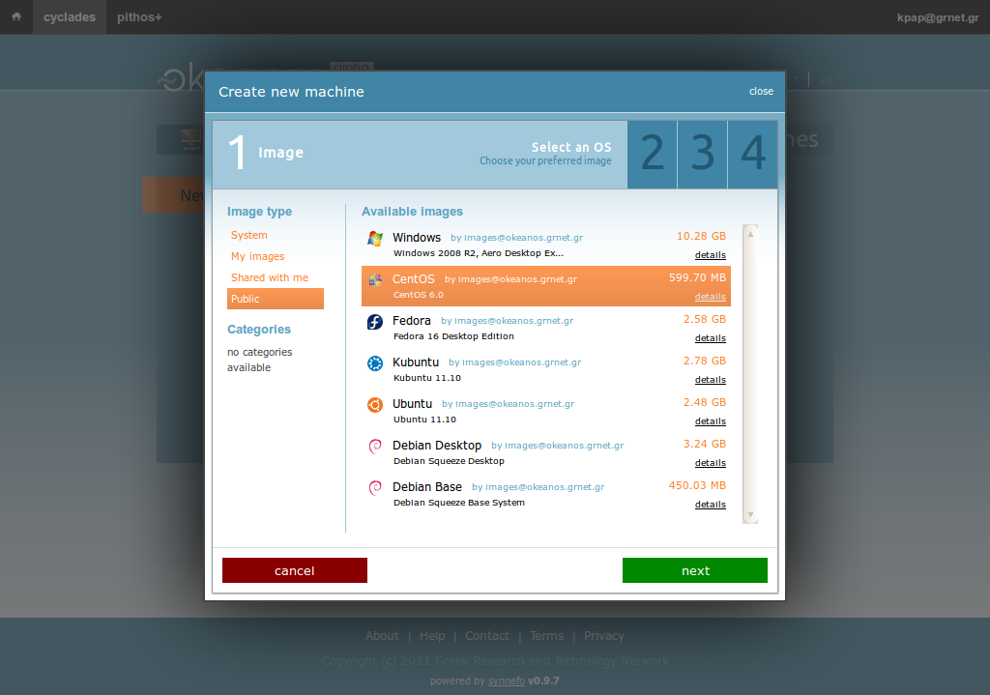

Slide 58
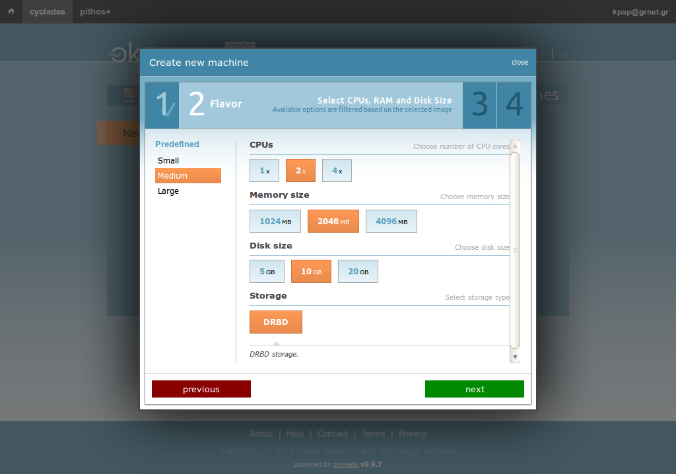

Slide 59
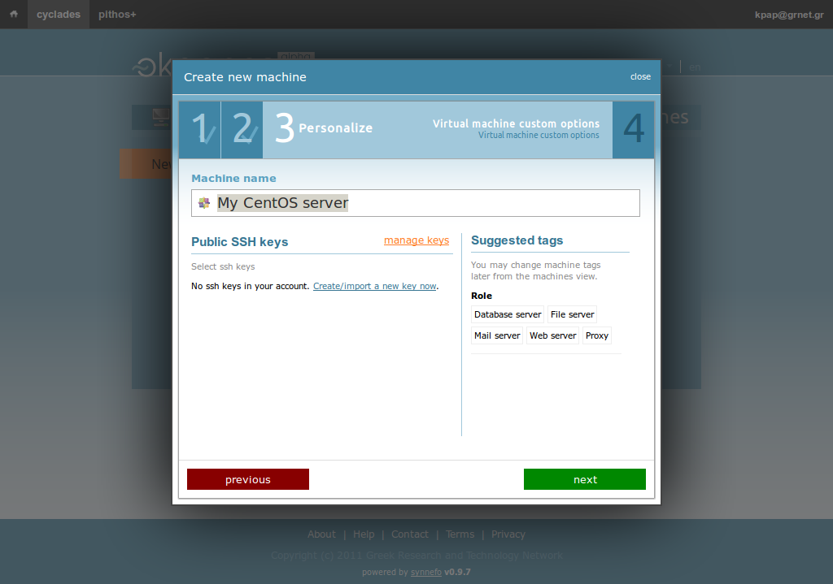

Slide 60
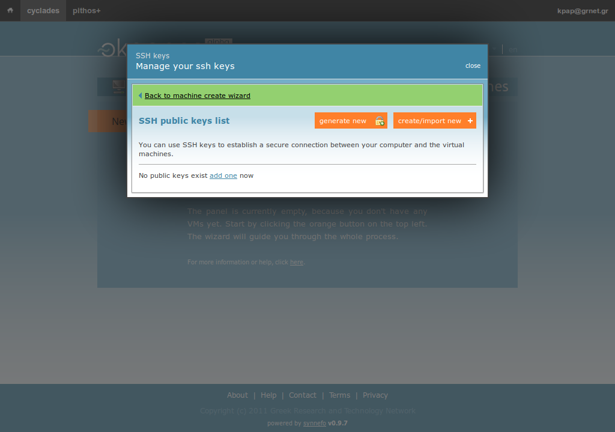

Slide 61
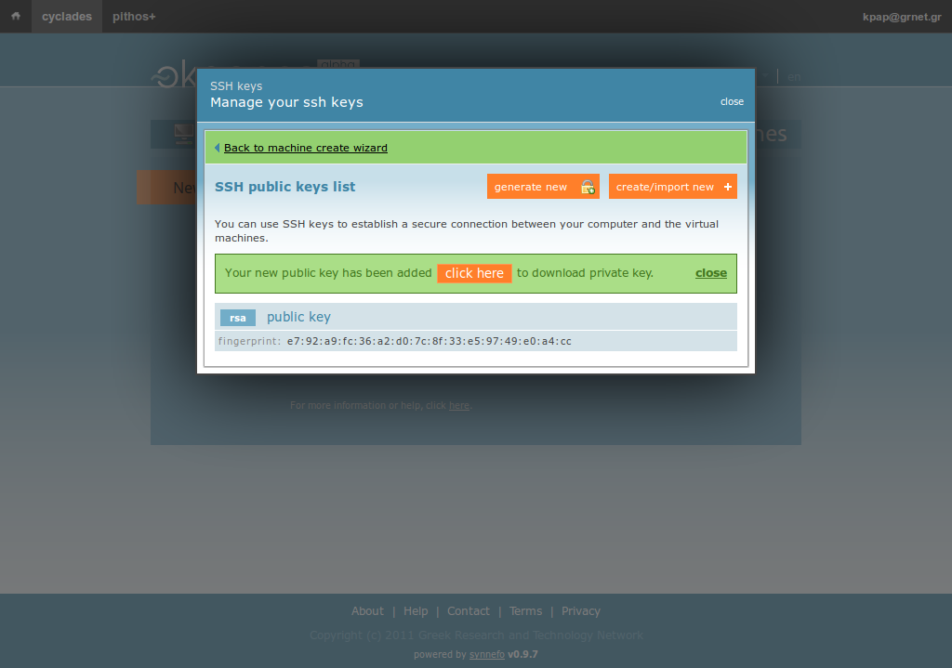

Slide 62
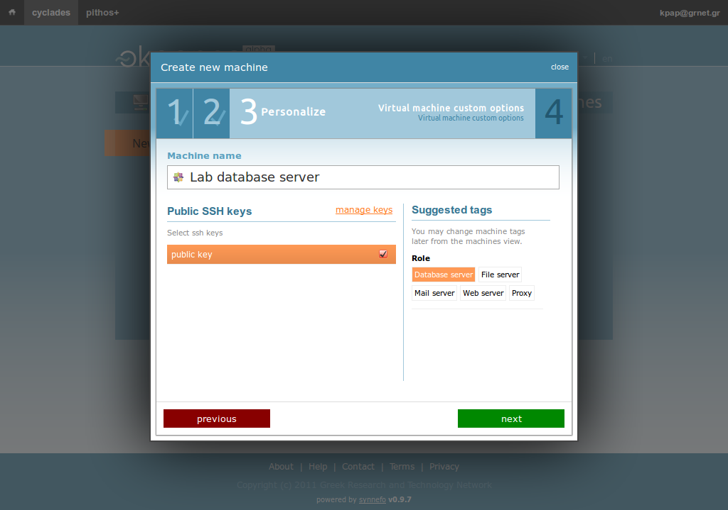

Slide 63
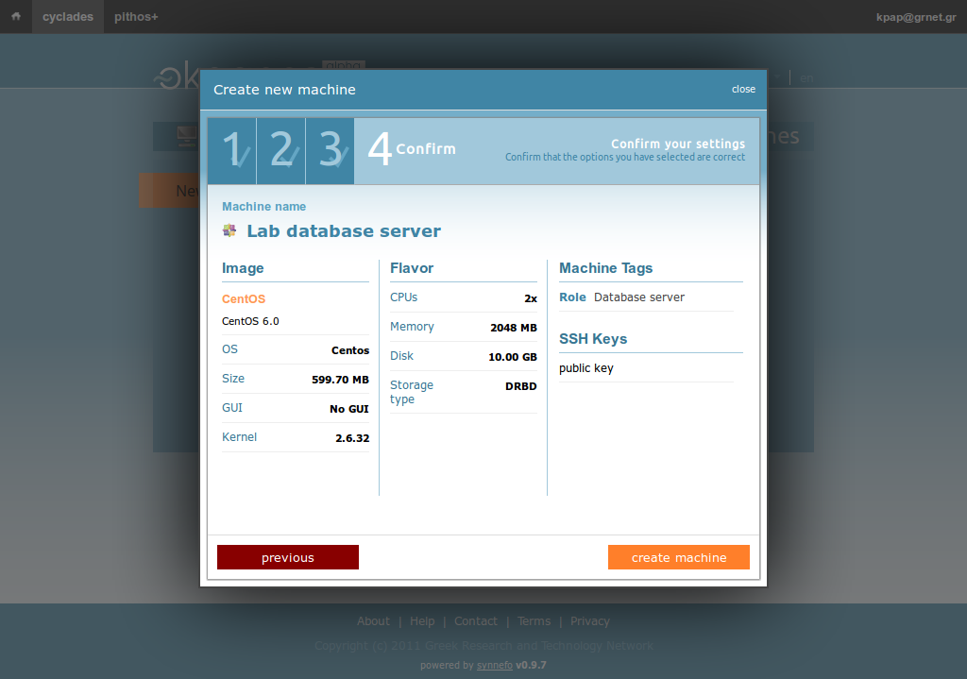

Slide 64
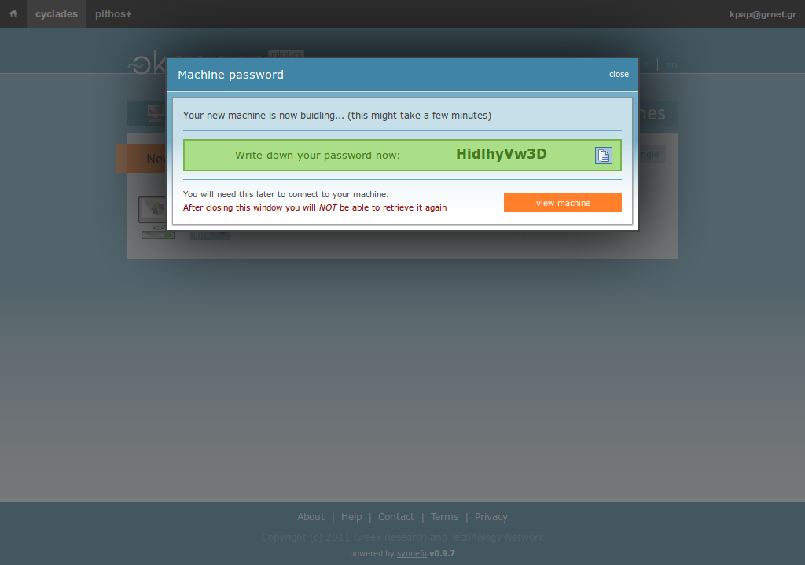

Slide 65
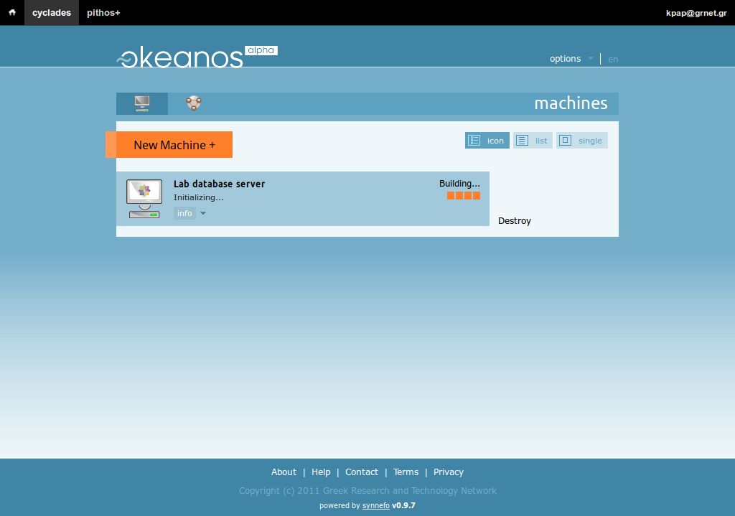

Slide 66
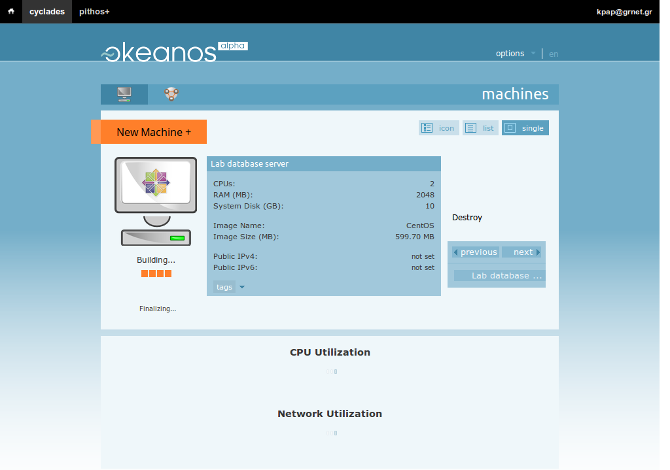

Slide 67
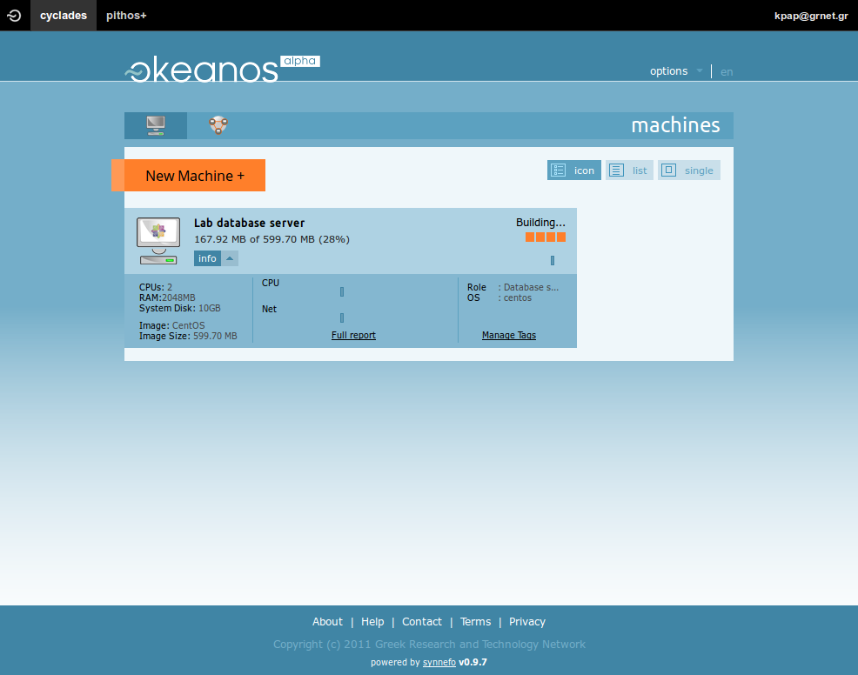

Slide 68
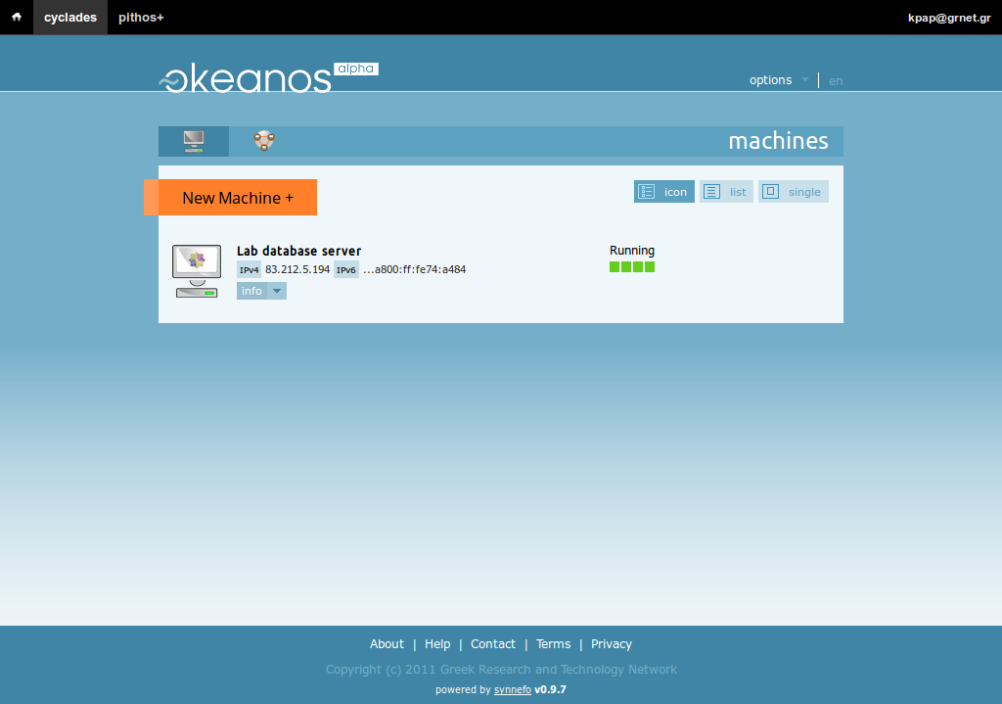

Slide 69
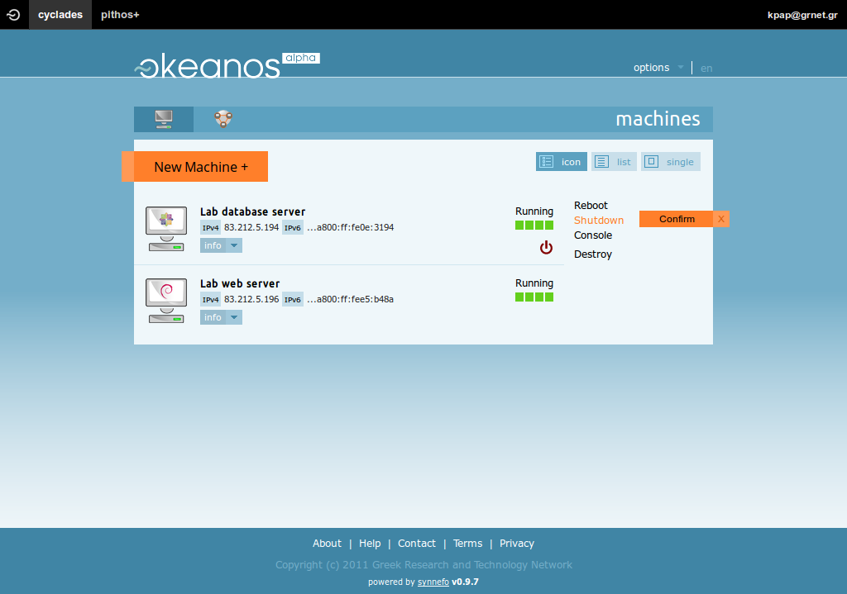

Slide 70
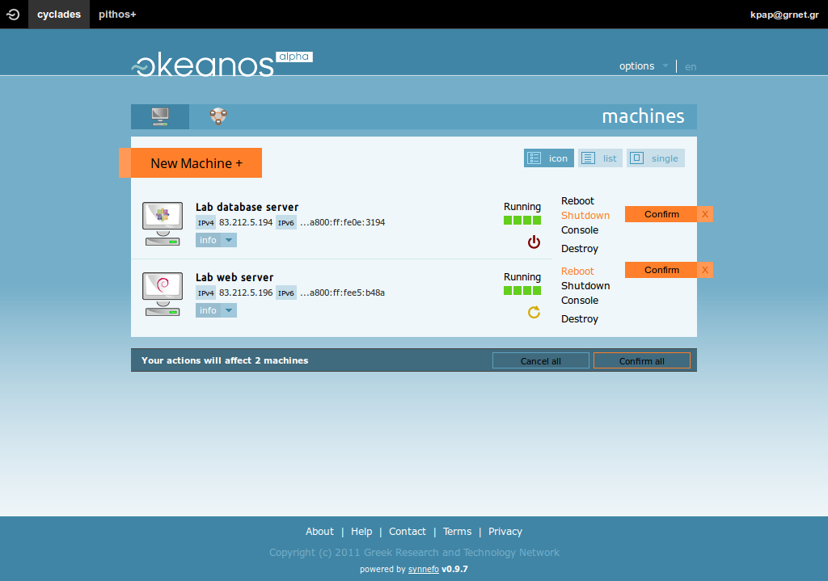

Slide 71
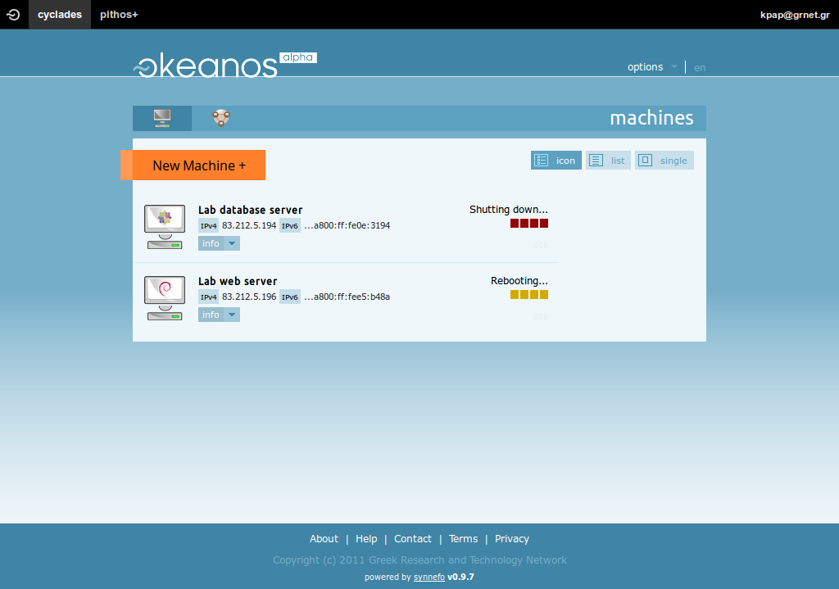

Slide 72
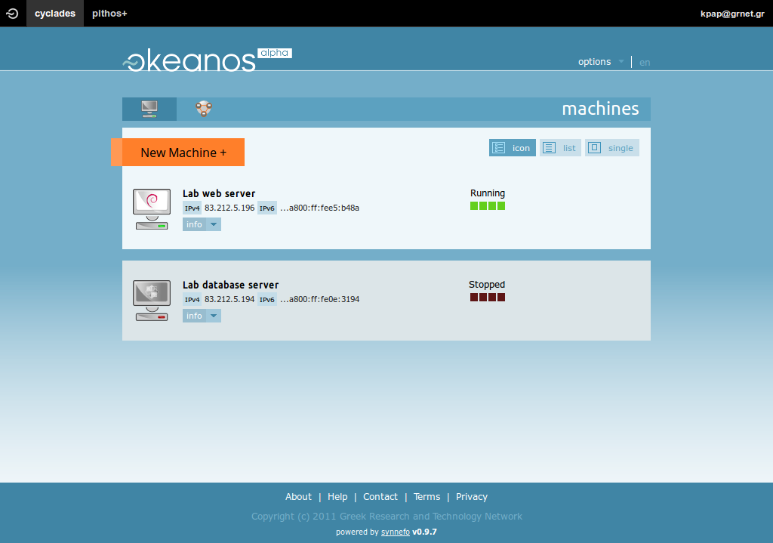

Slide 73
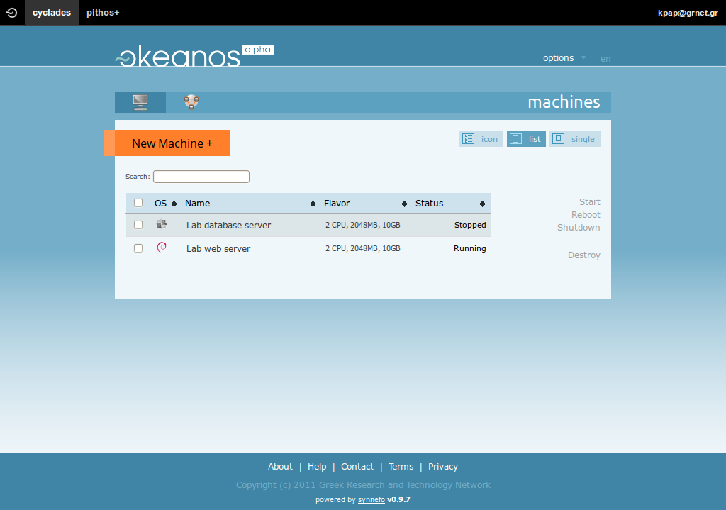

Slide 74
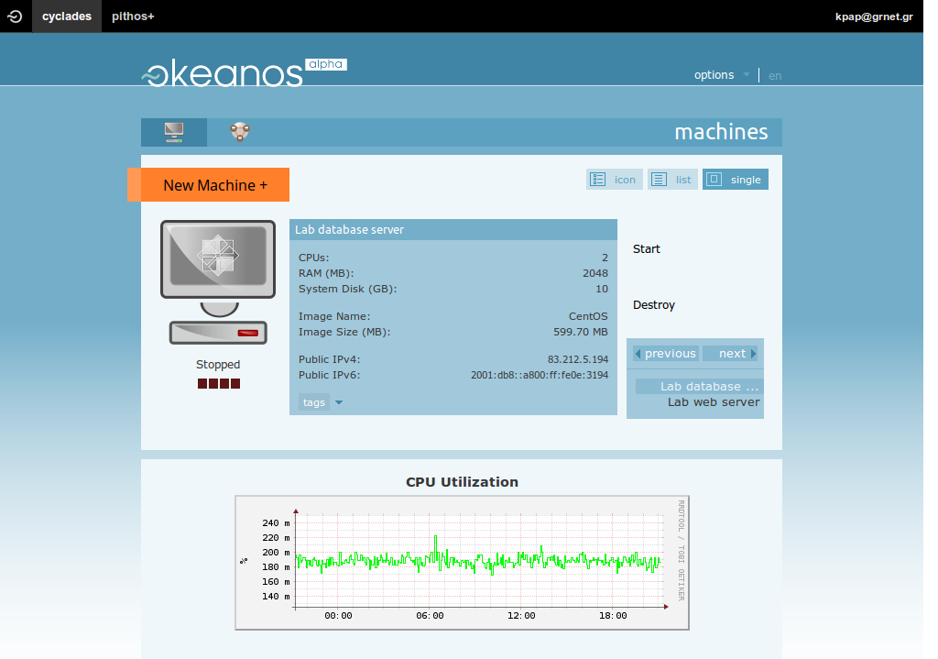

Slide 75
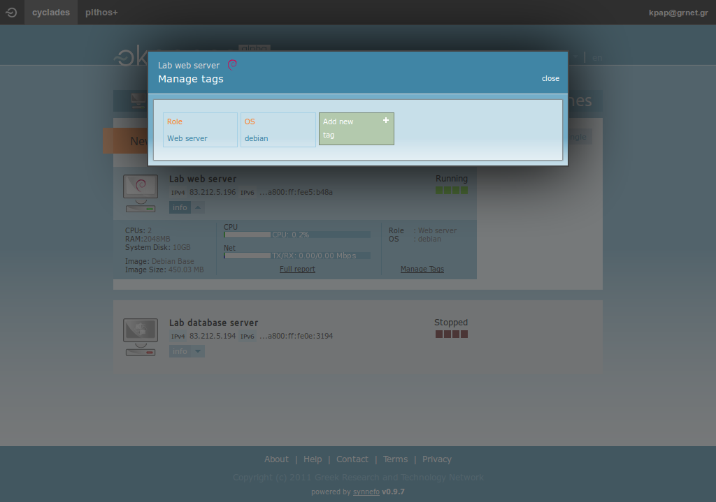

Slide 76
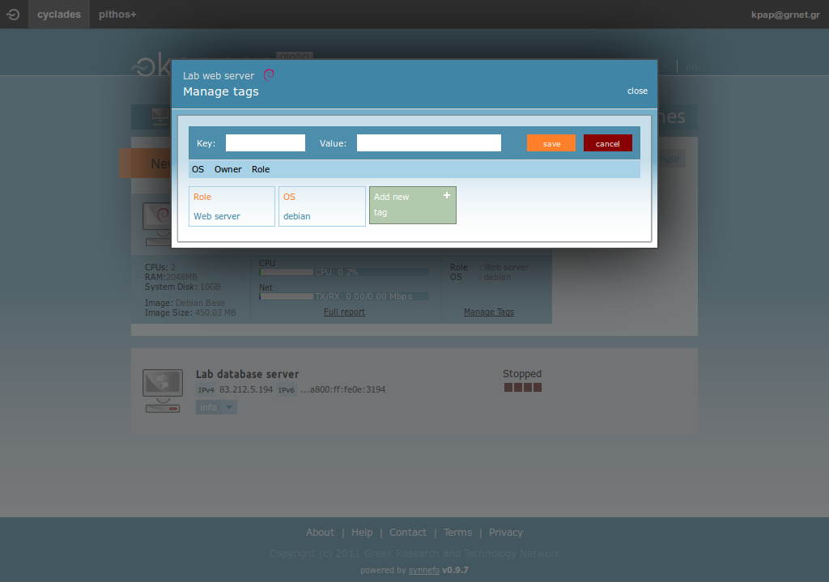

Slide 77
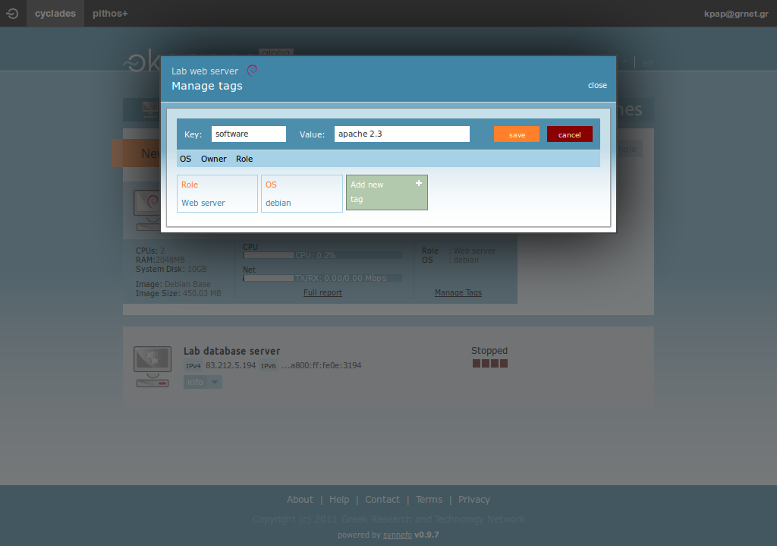

Slide 78
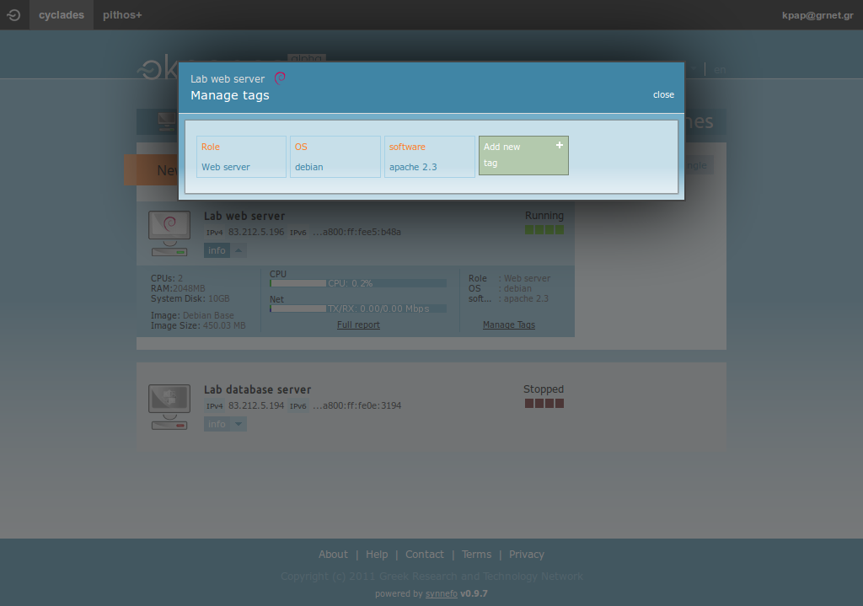

Slide 79
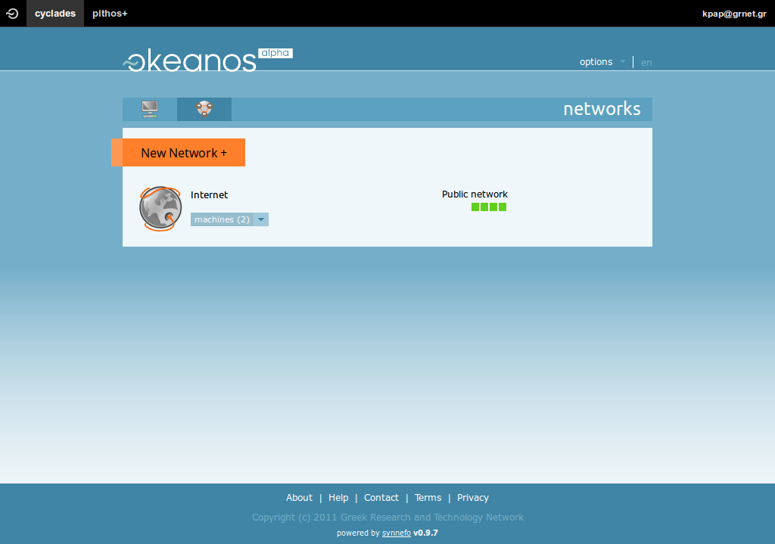

Slide 80
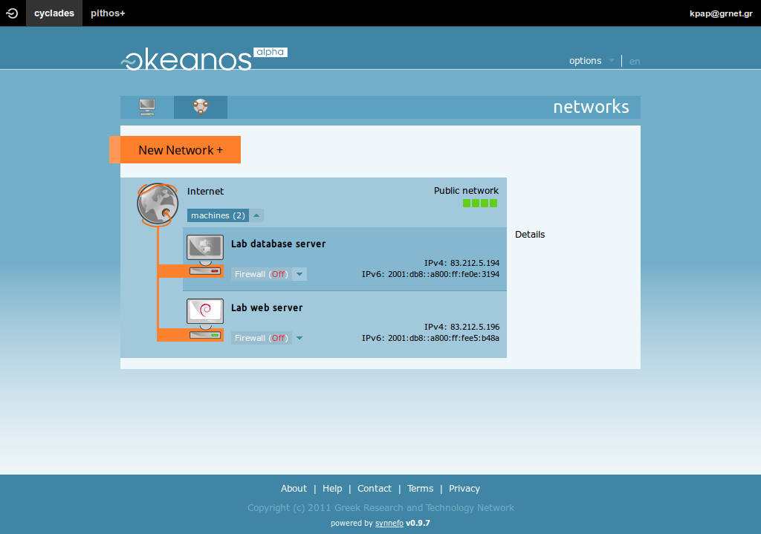

Slide 81
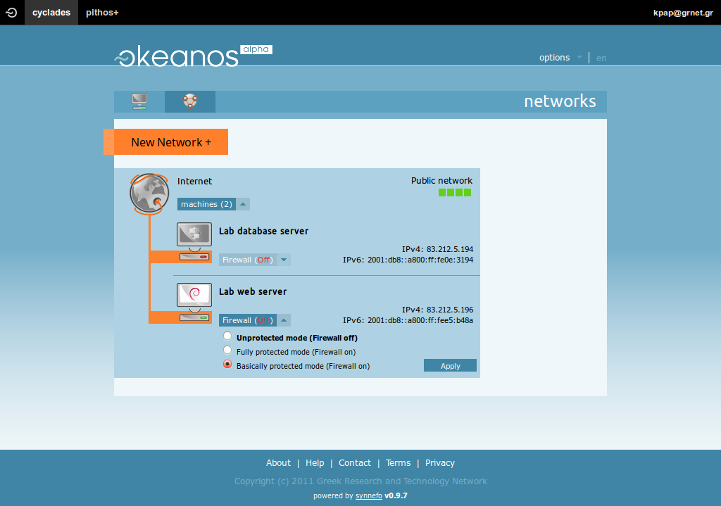

Slide 82
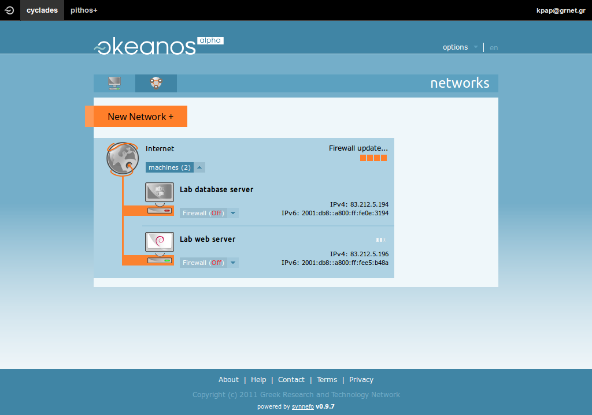

Slide 83
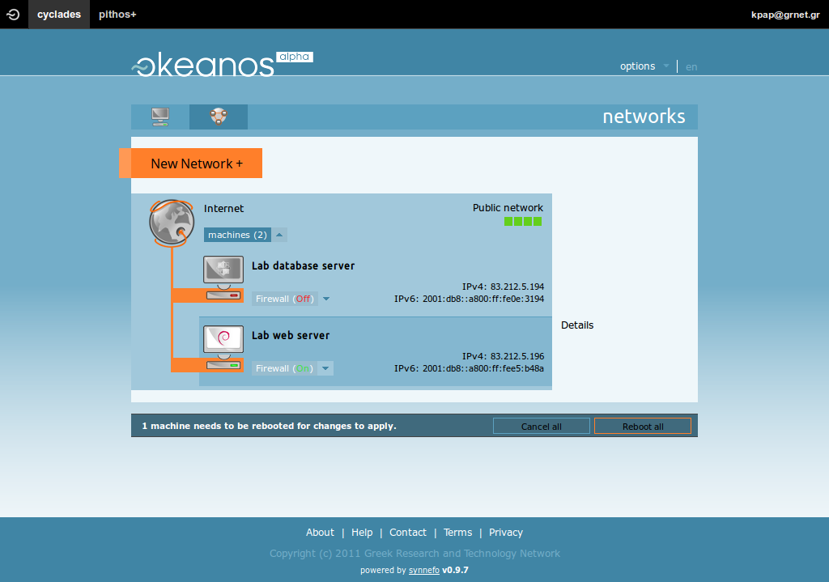

Slide 84
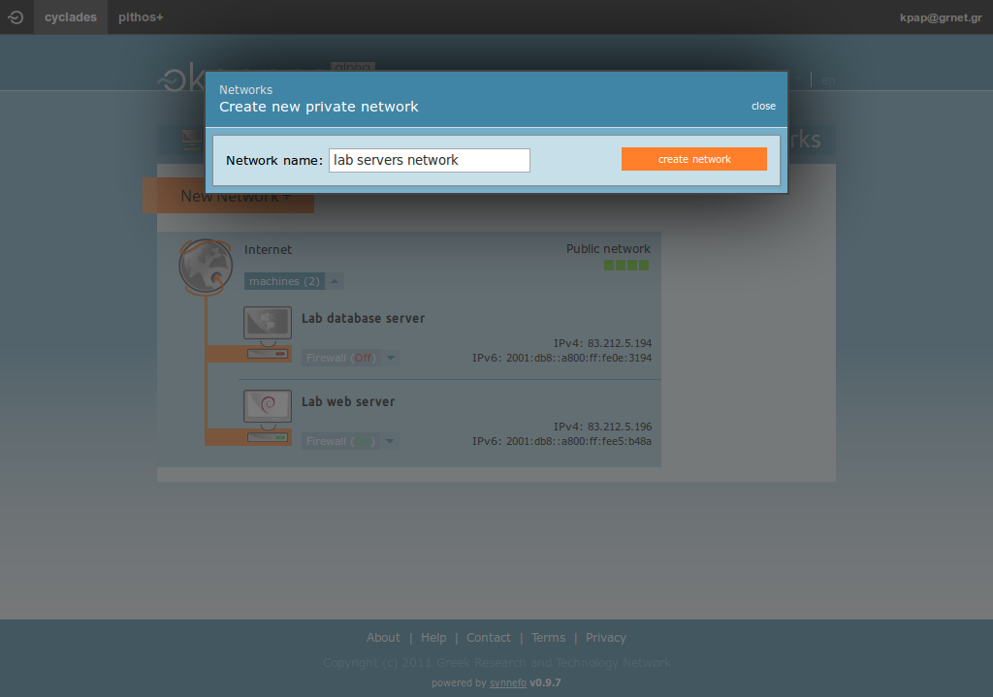

Slide 85
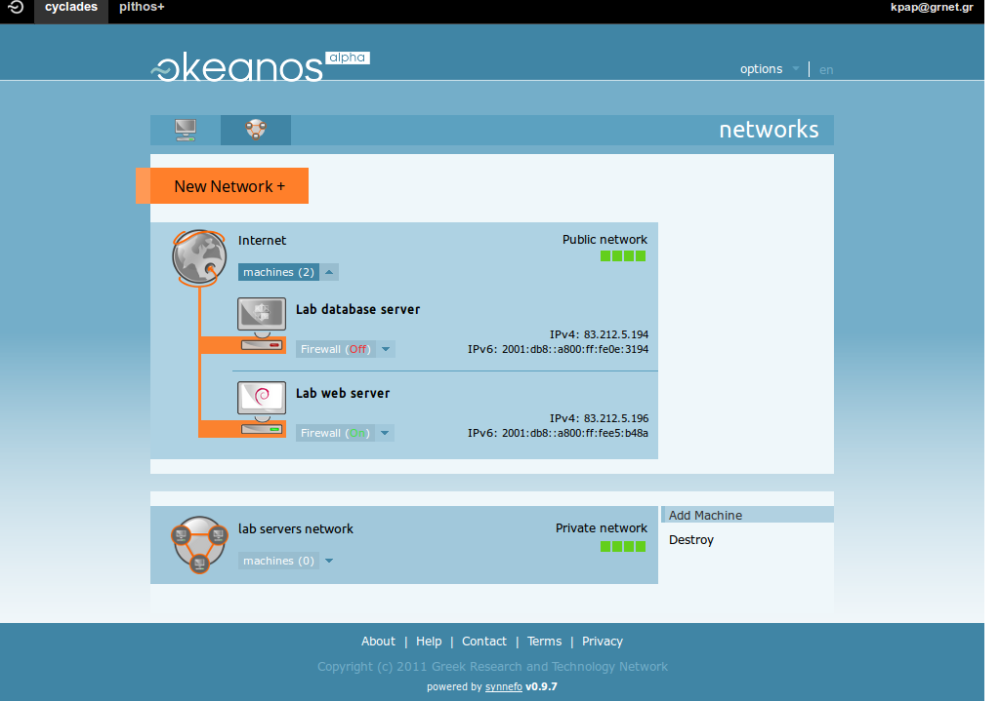

Slide 86
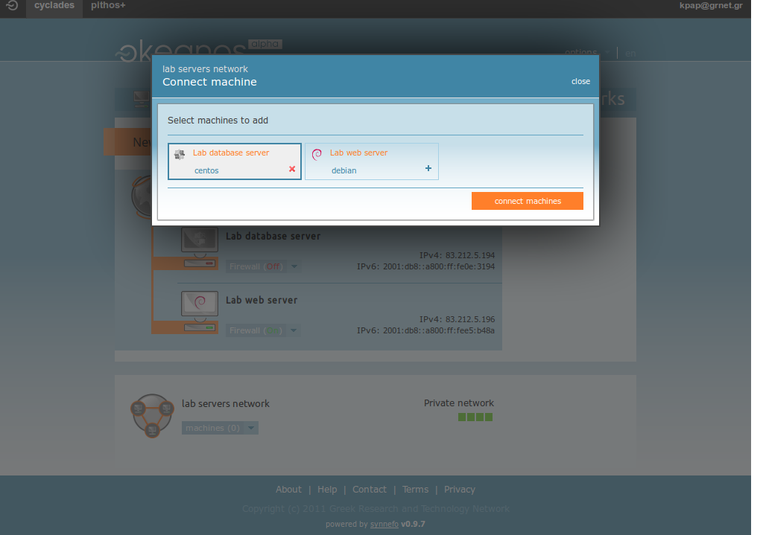

Slide 87


Slide 88


Slide 89


Slide 90


Slide 91


Slide 92


Slide 93


Slide 94


Slide 95


Slide 96


Slide 97


Slide 98


Slide 99


Slide 100


Slide 101


Slide 102


Slide 103


Slide 104


Slide 105


Slide 106


Slide 107


Slide 108


Slide 109


Slide 111
Opensource
Synnefo: Cyclades / Pithos+ / Astakos
  https://code.grnet.gr/projects/synnefo
  https://code.grnet.gr/projects/pithos
  https://code.grnet.gr/projects/astakos
snf-image
  https://code.grnet.gr/projects/snf-image
kamaki
  https://code.grnet.gr/projects/kamaki
vncauthproxy
  https://code.grnet.gr/projects/snf-vncauthproxy
pip install or apt-get install everything!

Slide 112
https://okeanos.grnet.gr

Slide 113
Thank You!
Questions?

Slide 114
Delivering IaaS for the Greek
Academic and Research Community
Vangelis Koukis
vkoukis@grnet.gr
Technical Coordinator, ∼okeanos Project

